Slide 1
P2P (Procure to Pay)
From Cradle to Grave:
Process of Requisition to PO

Slide 2


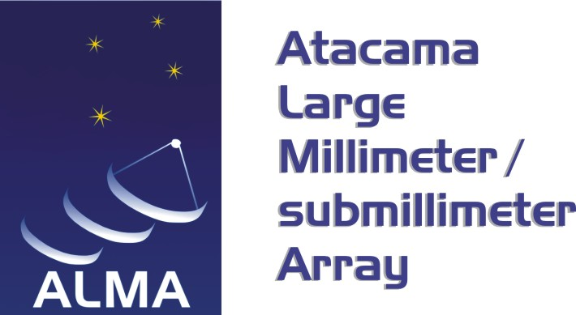

National Radio Astronomy Observatory
P2P Training Objectives
Establish parameters for purchases and describe the process
Explain the type of information needed for a purchase requisition (PR)
Explain the key decision points and documentation required for different levels of purchases
Clarify the roles and responsibilities involved in the purchasing process
Walk through the purchasing process
Provide links and contact information for additional resources

Slide 3
Contracts and Procurement’s Role
National Radio Astronomy Observatory
Procurement includes the selection of goods and services required to complete contractual deliverables and/or corporate initiatives based on availability, reliability and price to obtain the best value
Ensure vendor/subcontract compliance with contractual pricing, deliverables, and terms and conditions
Maintain records/logs to fully document procurement actions in compliance with procedures and applicable federal and commercial regulations

Slide 4
Goal: Seek competition and best value
National Radio Astronomy Observatory
In accordance with the NSF Cooperative Agreement and standard procurement practices, NRAO must seek full and open competition to the maximum extent practicable
NRAO achieves its competition goals by:
  Procuring products and services through an RFP/RFQ process
    Some purchases can be considered NRAO-wide for the sake of obtaining the best price structure
    Some purchases will stay on a local level depending on the best advantage for NRAO
Objective is to perform our (and your) fiduciary responsibilities by ensuring funds are expended effectively, efficiently and provide the best value to the Project, AUI/NRAO, and the Federal Government

Slide 5
Budget/Commitment Authorities
National Radio Astronomy Observatory
NRAO’s Contracts and Procurement Manual provides the guidelines on who can make contractual and financial commitments on behalf of the organization
  Directors/Division Leaders/Business Managers make budget decisions regarding the approval of a particular item against a specific project.
  CAP personnel commit the organization via Purchase Order and/or contract and bind all agreements made on behalf of the organization
  Purchase Orders establish a legal binding commitment between the vendor and the organization
Budget authority list and Commitment authority list at: https://info.nrao.edu/oas/cap/oas/cap/CAP-manual/CAP-Appendix-B.pdf

Slide 6
Requisitions
National Radio Astronomy Observatory
First step of establishing purchase orders: Requisitioners enter requisitions in JDE’s Procure-to-Pay (P2P)
Requisitioners can be end users or representatives from a department (an administrative assistant, for example)
Resources are available at the Contracts and Procurement webpage (https://info.nrao.edu/oas/cap) including P2P instructions and useful forms

Slide 7
What is needed for requisitions
National Radio Astronomy Observatory
Information required for requisitions:
  Account number(s) – Business Unit and Object Code
  Approval route
  Needs statement (explain why the product/service is required)
  Source & Pricing Justification form (orders over $3,500)
  Statement of Work or specifications
  Other information as applicable (i.e. quotes, suggested vendors, notes to Buyers, etc.)
Requisitions are assigned to approvers based on approval routes and dollar amounts
  Route list at: https://info.nrao.edu/oas/cap/approval-route-matrix

Slide 8
National Radio Astronomy Observatory
Needs Statement
    All purchase requisitions, no matter the dollar amount, must include a brief statement explaining why the product is required
Example: “This component is required for Band 7 prototype development.”
The needs statement can either be added as text on the requisition header or attached as an Office document

Slide 9
National Radio Astronomy Observatory
The Source and Pricing Justification Form
Source and Price Justification (SPJ) Form is required on any purchase of $3,500 or more
The SPJ form is located in P2P or on the NRAO webpage
The form is interactive and can be filled out online, saved with your unique file name and attached to your requisition
  This will ensure that the Buyers will receive the completed form at the same time as the requisition

Slide 10
National Radio Astronomy Observatory
Responsibility/Accountability for the Sourcing Form
The Requistioner:
  knows what is needed to meet his/her own requirements and needs to state those requirements on the form or a document attached to the form
  records the information already gathered in the course of researching the purchase onto the Source and Price Justification Form, when applicable

Slide 11
Responsibility/Accountability for the Sourcing Form (cont.)
National Radio Astronomy Observatory
The Buyer:
  is responsible for accuracy, completeness, and ensuring compliance with the NSF Cooperative Agreement, federal Uniform Guidance regulations, and procurement best practices.
  reviews the requisitioner’s request and the information provided in order to make a sourcing decision
  is required to sign the form, verifying all the information
  Finding the right item at the best price, under the best conditions, is a joint effort between Procurement and the Requistioner.

Slide 12
National Radio Astronomy Observatory
Purchase Justifications for $3,500 or greater
If a sole source selection is recommended, THE SOURCE AND PRICE JUSTIFICATION FORM MUST BE COMPLETED by the requisitioner. If not, the requisitioner should complete all applicable sections, and the Buyer will finish the form and sign.
The completed form needs be attached to the requisition header. Please make a note of the file in the Justification field.

Slide 13
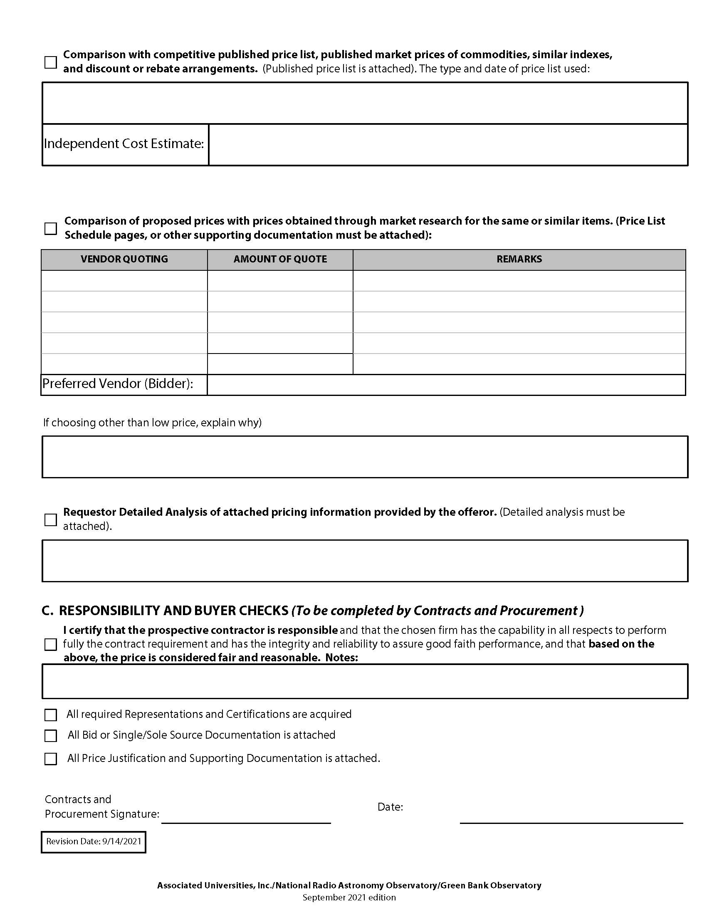
National Radio Astronomy Observatory
The Source and Pricing Justification Form
Pages 1 and 2
Basis for Award - Price Justification - Responsibility and Buyer Checks

Slide 14
National Radio Astronomy Observatory
Structure of the Form
BASIS FOR AWARD
This section is used to indicate whether the purchase is Competitive or Single/Sole Source
If Single/Sole Source, check that box and go to pages 3 and 4 of the form
If the Competitive box is checked:
  The Requisitioner lists potential suppliers and notes any comments on the budgetary quotes in the Competitive Analysis section

Slide 15
National Radio Astronomy Observatory
Structure of the Form – Basis for Award (cont.)
  If a Requistioner obtains quotes on an item(s) for purchase, the Requistioner must inform the supplier that the quote or bid is “budgetary”
  The Buyer must verify the quote to ensure that firm quotes are acquired for any purchase in excess of $3,500 (and to satisfy the requirement that quotes must be acquired by a Buyer)
  If a selection is made to a supplier other than the lowest bidder, state your reasons for the choice
  Always support your decision by demonstrating how it represents the “best value”

Slide 16
National Radio Astronomy Observatory
Structure of the Form - Price Justification (Section II)
With initial input from the Requistioner, this section will be completed by the Buyer
This section is used to explain the selection of a supplier based on competitive evaluation, pricing information or market based pricing analysis
The Sourcing form lists 4 options for acquiring quotes
  The first 2 options will be used most often and can sometimes be completed by the Requistioner. They are:
  1. Responses to a solicitation (expected to be used most often)
  2. Comparison to recently purchased similar items (if the same or very similar items were purchased within the last year)

Slide 17
National Radio Astronomy Observatory
Structure of the Form - Price Justification (Sect. II) – (cont.)
  The final two options will likely need Buyer assistance since they require a deeper level of research into price comparisons.
  3. Comparison to competitive published price lists (Usually done by the Buyer, although Requisitioner may be asked to provide information)
  4. Comparison of prices using market research on the same or similar items (Usually done by the Buyer, although Requisitioner may be asked to provide information)

Slide 18
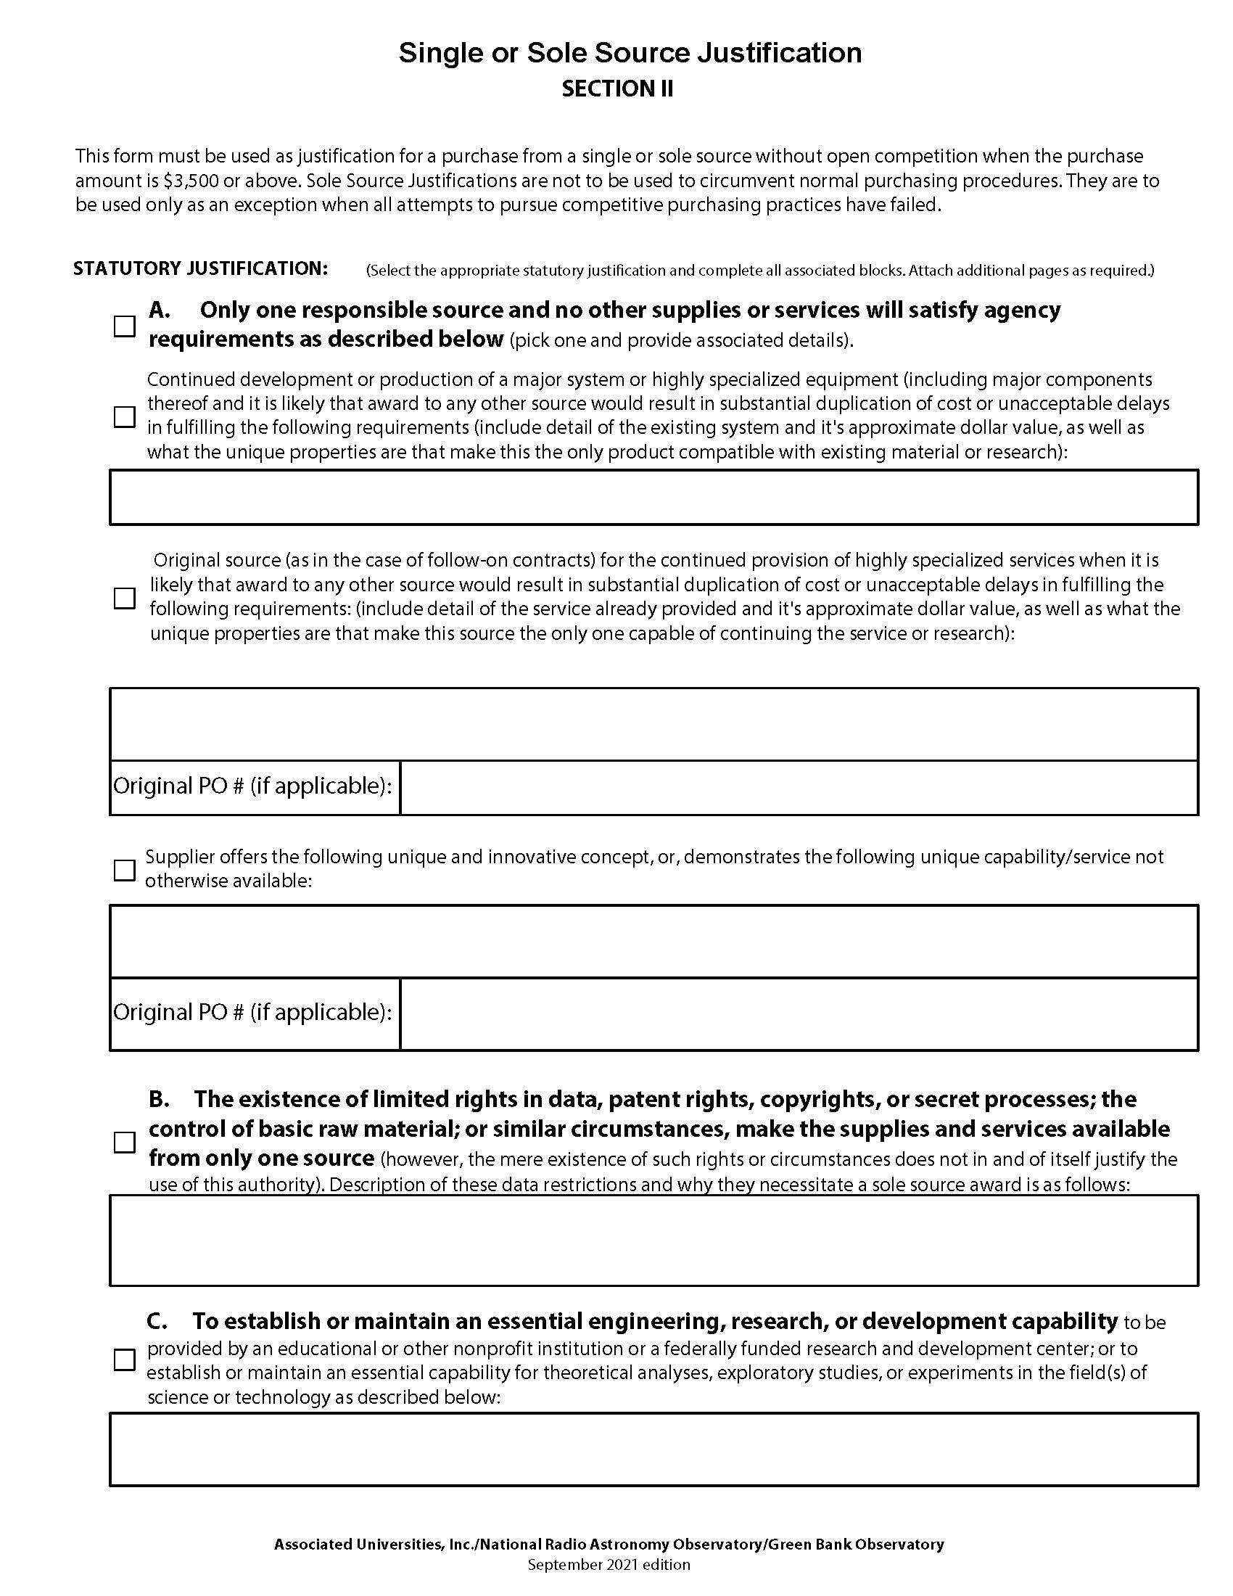
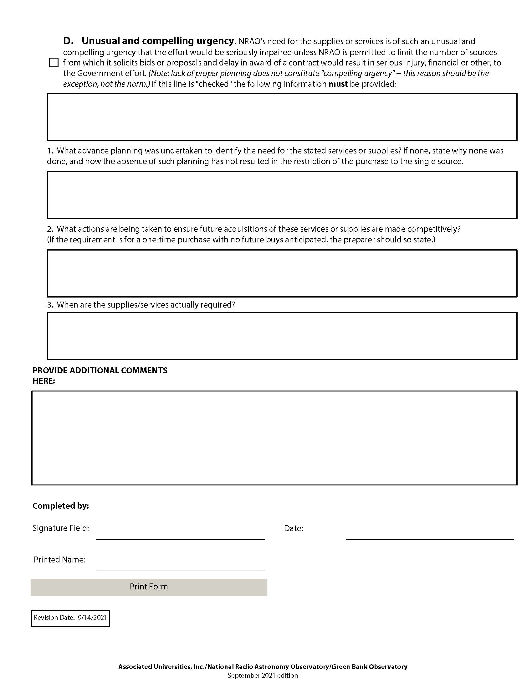
National Radio Astronomy Observatory
Structure of the Form - Single/Sole Source Justification.
If you select Single/Sole Source on Page 1, you must complete and sign pages 3 and 4.

Slide 19
National Radio Astronomy Observatory
Single or Sole Source Justification
This section documents and justifies the Single/Sole Source purchasing decision.
This portion of the form must be signed by the requistioner.
There are 4 categories on the Single/Sole Source Form.
  Select the most appropriate category and fill in the justification details in the applicable box.
  If your justification does not fit into one of the 4 categories on the form, it might not be considered a Single/Sole Source, and you might have to seek competition.

Slide 20
National Radio Astronomy Observatory
Importance of the Source and Price Justification Form (SPJ)
The Source and Price Justification Form is meant to encourage and ensure competition in all procurements, particularly those in excess of $3,500
The Source and Price Justification Form provides a consistent format for recording our efforts to compete our purchases and to document our reasons for award
If you recommend a Single or Sole Source purchase, you need to have compelling reasons to do so, and those reasons must be documented and fit into the categories listed on this form

Slide 21
P2P Requisition Entry
National Radio Astronomy Observatory
Within your JDE Enterprise One menu, choose the Requisitioning tab
Choose Purchase Requisition Entry - Purchase to Account
Click the “Add” button (the green plus sign)

Slide 22
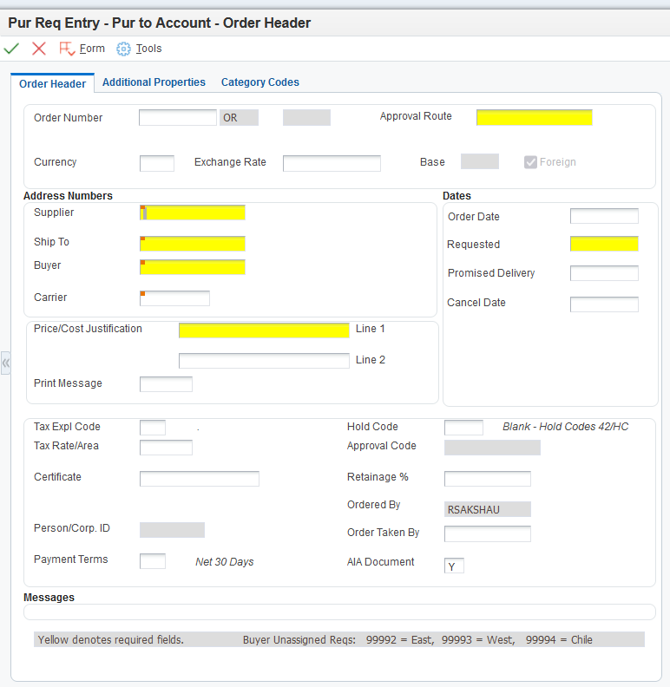
National Radio Astronomy Observatory
Order Header screen
The required areas are highlighted in yellow

Slide 23
National Radio Astronomy Observatory
Required Fields on Order Header
Business Units/Approval Routes can be found at: https://info.nrao.edu/oas/mis/wbs
Supplier/Employee #: enter your employee ID number
Ship To: enter location goods are shipping to
Buyer: enter applicable 5-digit code (see codes listed in Messages box)
Date Needed: enter requested delivery/completion date
Price/Cost Justification: enter justifications, depending on the dollar level (see following slides)

Slide 24
National Radio Astronomy Observatory
Purchase Justifications for ANY Dollar Value
If the dollar amount is over $3,500, put “See attached SPJ Form” in the justification field
If the value of the requisition is less than $3,500:
  the Source and Price Justification Form is not required
  enter a brief justification for making the purchase in the fields provided on the header
Phrase your justification with a few words:
  Examples of justifications for a small dollar requisition might be: “best price of 3 vendors (Newark, DigiKey, Allied);” “internet search – best of 3 vendors (New Egg, CDWG, PC Mall);” “catalog search – best of 3 vendors (MSC, Grainger, McMaster);” etc.

Slide 25
National Radio Astronomy Observatory
ANY Dollar Value Justification (continued)
If more space is needed:
  write “See note in header” in the fields provided on the header screen (so you are fulfilling the requirement to make an entry there).
  add your information as a text attachment to the requisition header.
Critical to processing any purchase requisition: Some type of justification will have to be entered on the header screen of your requisition regardless of the dollar value of the purchase

Slide 26
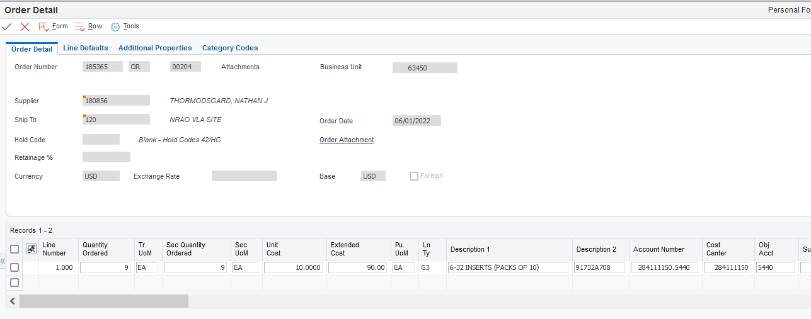
National Radio Astronomy Observatory
Order Detail Screen
Enter line details including description, quantity, price and account numbers

Slide 27
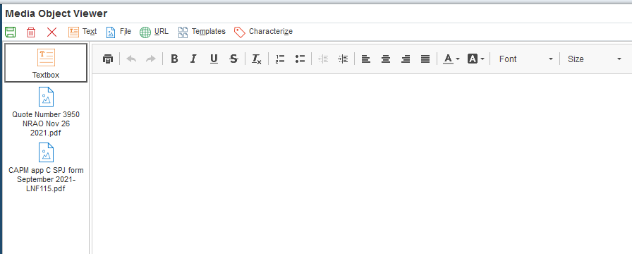
National Radio Astronomy Observatory
Attachments can be uploaded to Order Header or Order Detail

Slide 28
Purchase Order Placement
National Radio Astronomy Observatory
Buyers take approved requisitions and:
  Gather quotes or proposals
  May request additional info from requisitioners
  Review object codes to ensure object code matches the purchase
  Ensure vendors completed all required paperwork
  Make best value source selection based on evaluations
  Generate PO, send it to vendor and requisitioner
Requisitioner and Buyer monitor order in anticipation of completion. Any changes to the order or agreement after award must be formally made by the Buyer or CAP representative.

Slide 29
Invoicing and Receiving
National Radio Astronomy Observatory
The receiving person at each site signs the goods in after verifying with the requisitioner that the item is correct and consistent with the order
Likewise, an invoice is reviewed and approved by the requisitioner and handed off to the receiving clerk
Then, the receiving clerk enters a receiver into P2P, a copy of the receipt is filed in the receiving department, and the original goes to the Buyer so that the PO can be closed
Fiscal department pays the vendor
Closeout procedures initiated by CAP personnel where applicable

Slide 30
Key Points
National Radio Astronomy Observatory
Compliance with NRAO policies and government regulations is critical to our ability to conduct business and maintain an acceptable purchasing system
Requestor identifies sources and completes requisition, including a Needs Statement and, if $3,500 or greater, a Source and Price Justification Form
CAP approves all purchases and notifies vendor of selection decision – all purchases require a CAP-issued PO to place order
Purchases placed outside the PR/PO process are not recognized as corporate commitments – they would be personal liabilities

Slide 31
Resources
National Radio Astronomy Observatory
Contracts and Procurement webpage:
  https://info.nrao.edu/oas/cap
Email list for contacting procurement personnel:
  purchasing@nrao.edu
Contracts and Procurement personnel located at each site:
  Charlottesville
    CAP Manager Richard Sakshaug, rsakshau@nrao.edu
    Buyer Jose Cuenca, jcuenca@nrao.edu
  Green Bank
    Buyer Marsha Anderson, manderso@nrao.edu
  Socorro
    Purchasing Supervisor Magdalene Romero, mromero@nrao.edu
    Buyer Lia Romero, lromero@nrao.edu
    Buyer Barbara Harris, bharris@nrao.edu
  Albuquerque
    Buyer Genevieve Aragon, garagon@nrao.edu

Slide 32
Additional Resources
National Radio Astronomy Observatory
Subawards and Consultant Agreements:
  Contracts Specialist Daphne Anderson, danderso@nrao.edu
Software Licenses and Maintenance Agreements:
  IT Contracts Specialist Lisa Bushey, lbushey@nrao.edu
Grants & Work for Others Support:
  Grants Administrator Grace Lipscomb, glipscom@nrao.edu
Import/Export Compliance Assistance:
  Export Compliance Officer Joyce Ford, jaford@nrao.edu

