Slide 1
Exploring Western Australia
May – August 2016
Lewis, Cathryn and “The Ute”
Notes:
Many years four wheel driving and exploring.
Hadn’t done a long trip for a few years because of work commitments.
Cathryn wanted to see the site where we had built ASKAP – after listening to me talking about it for more than 10 years!

Slide 2
Australia is big…
6th largest country
7.7 million km² (lower 48 = 8 million km²)
And largely empty
Just 25 million people
(US 326m)
Population density 3.2 / km²
(US 40.8 / km²)

Slide 3
Even Western Australia is HUGE…
2.5 million km² (~ Texas + Alaska)
Second largest country subdivision in the world (after Russia’s Sakha Republic)
And much more empty
2.6 million people
(1.7 m in Perth, 92% in the SW)
The second largest WA city has a population of just 71,000
1 person per km² (average) even MT and WY have 2 / km²
Notes:
Texas population 28 million
Alaska 750,000
MT = Montana WY = Wyoming
Alaska pop density ~ 0 / km²

Slide 4
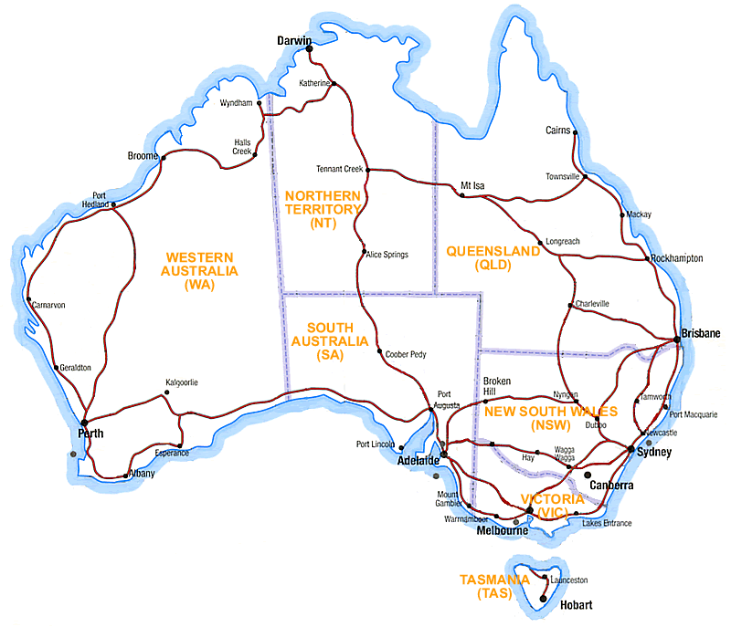
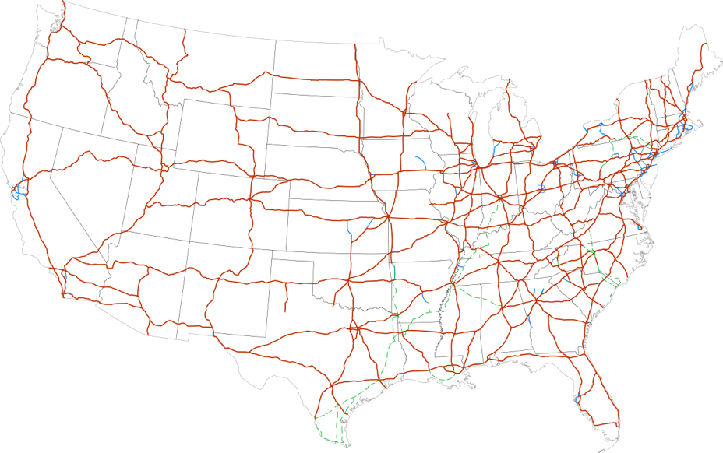
…The highways, all of them….
Notes:
But we didn’t use them much

Slide 5
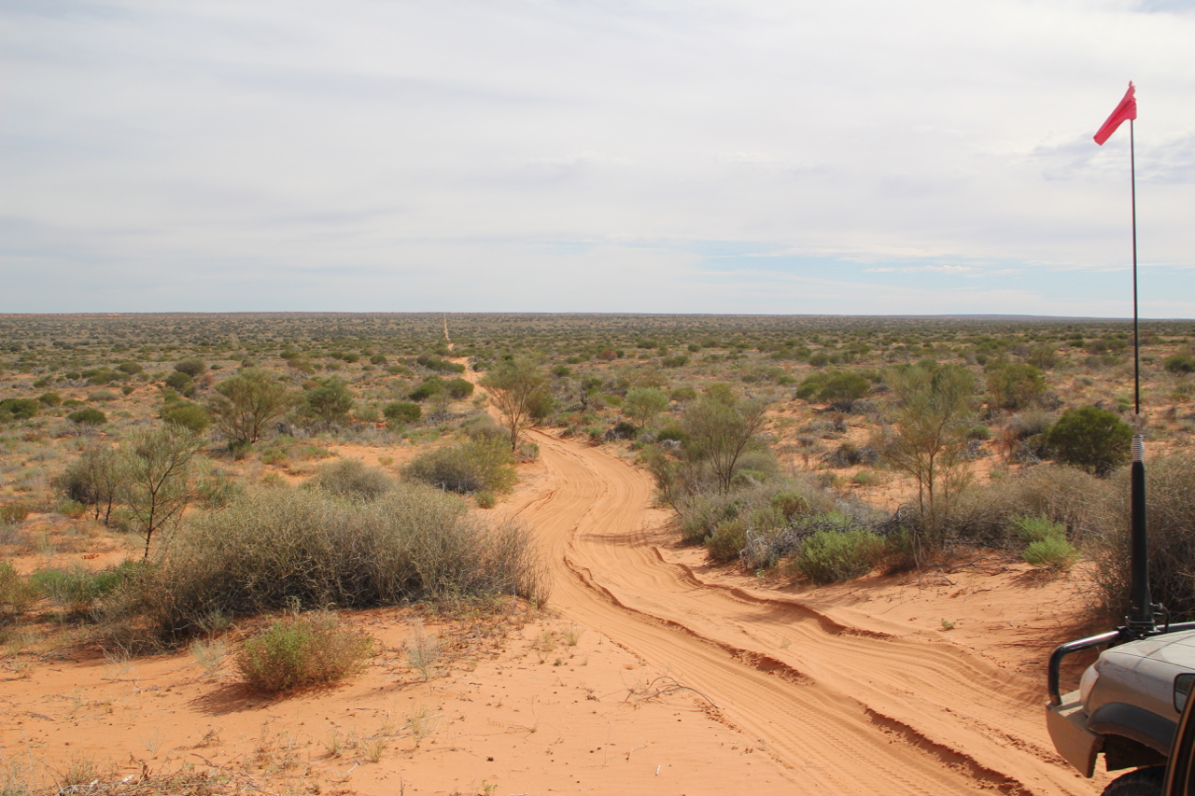
Off the Beaten Track
19,800 km (12,000 miles)
3,000 litres of Diesel (800 US Gallons)
1,600 photos
81 pages of travelogues to friends and family
Notes:
Note the sand flag!
Flag and Channel 10 UHF calls are essential to avoid head-on collisions.

Slide 6
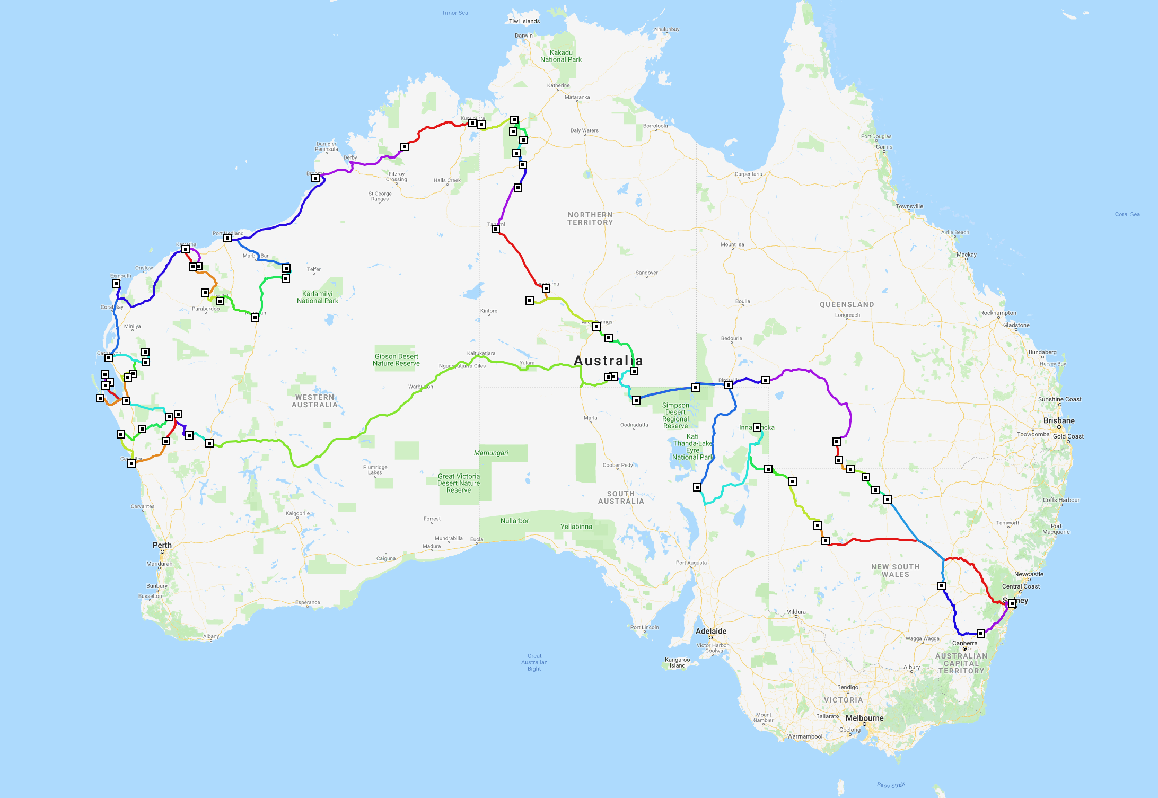
Our Route
Munja
Track
World
Heritage
Coast
Newhaven
Simpson Desert
Great
Central
Road
Boolardy
Wooleen

Slide 7
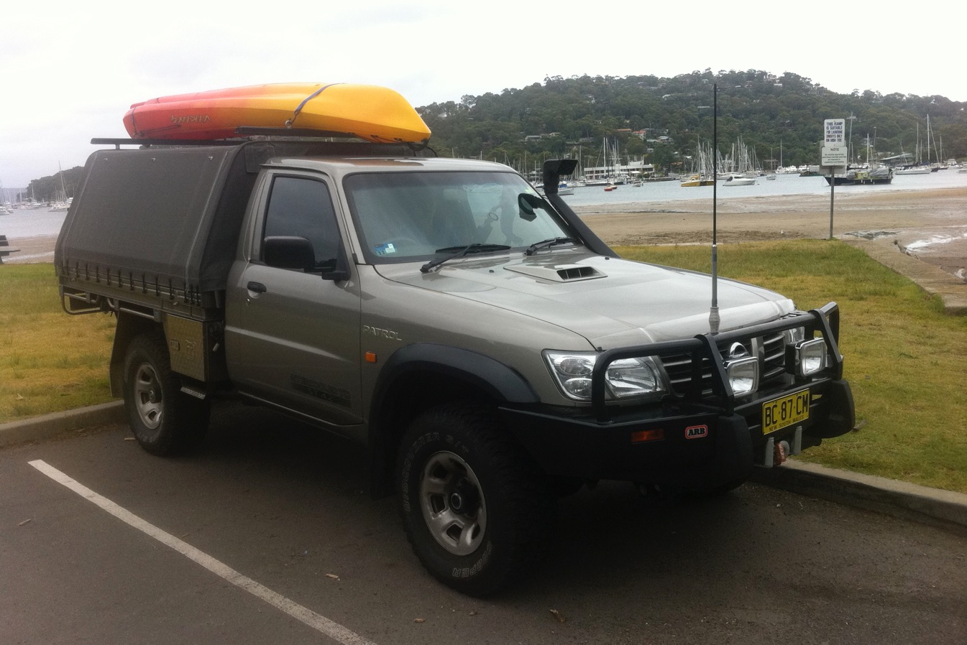
The vehicle
2006 Nissan Patrol Coil Cab
Dual Batteries
185 litre diesel tanks
120 litre stainless steel water tanks
Air compressor
UHF & HF radios, PLB
2 x 12V refrigerators

Slide 8
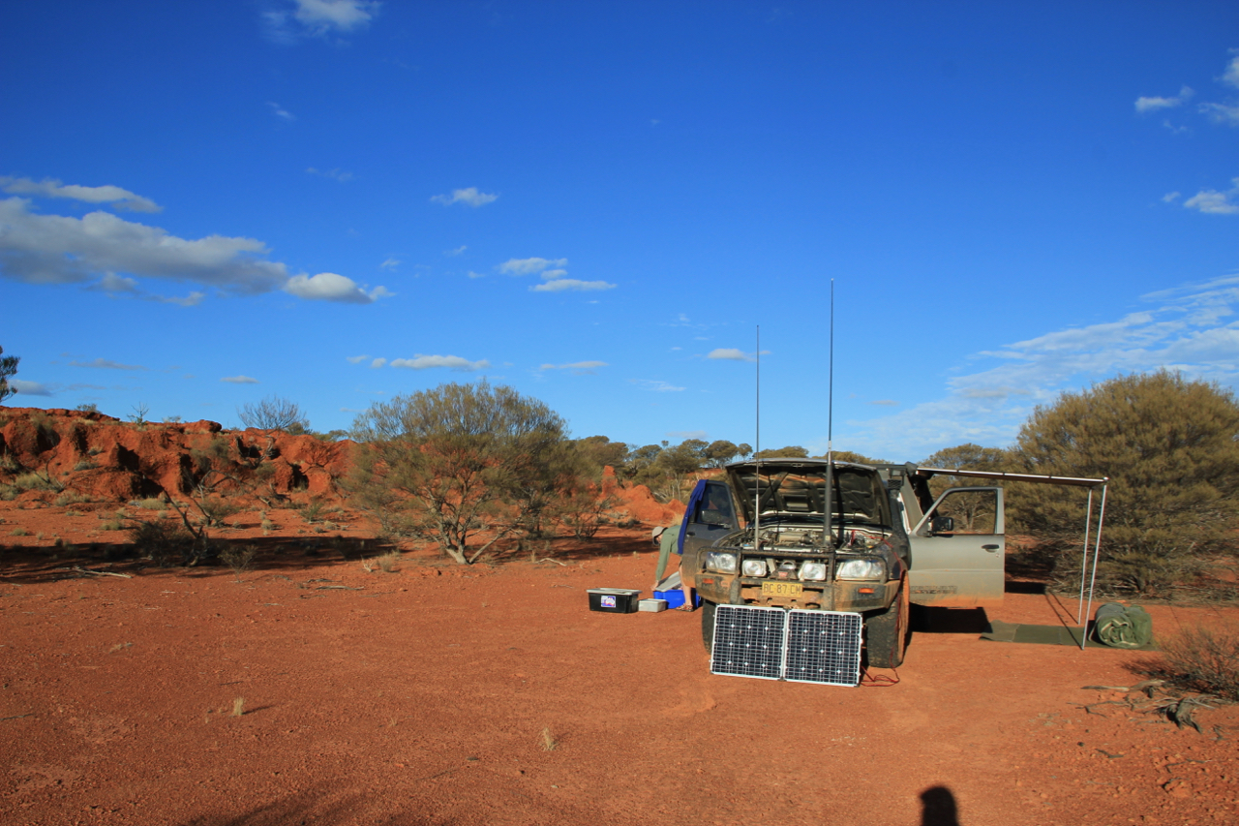
Bits & pieces
10000 lb electric winch
Hand winch
Maxtrax sand ladders
Hilift jack
2 Spare tyres
Solar PV panels
240V inverter

Slide 9
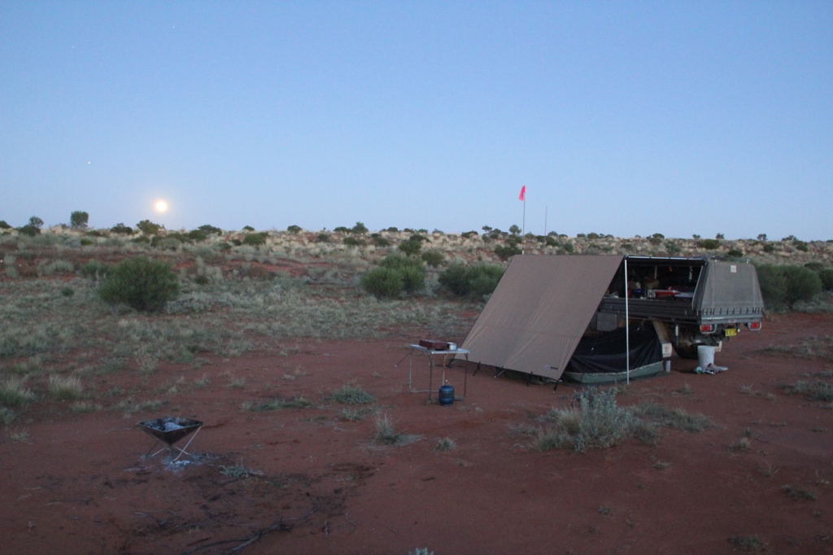
The setup
Swag
Awning
Fire pit
Propane stove
12V shower & pump

Slide 10
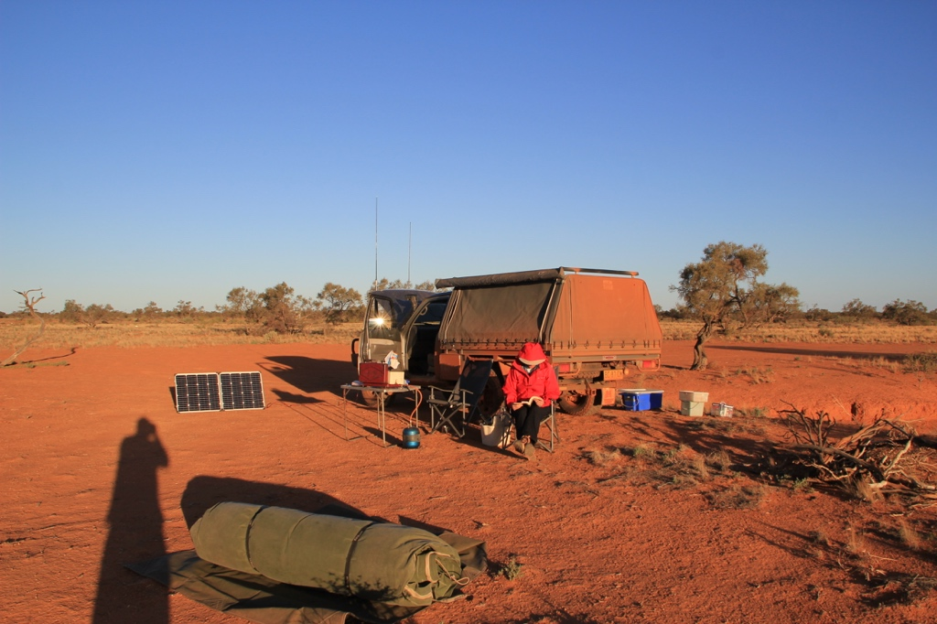
What’s a swag?
A canvas bedroll
The mattress and bedding stays inside when you roll it up
“Waltzing Matilda” is a reference to carrying a simple swag
Ours has a pole to hold the foot up, and a rope to the ute holding the head up
And very, very fine mesh to keep the bloody bugs out

Slide 11
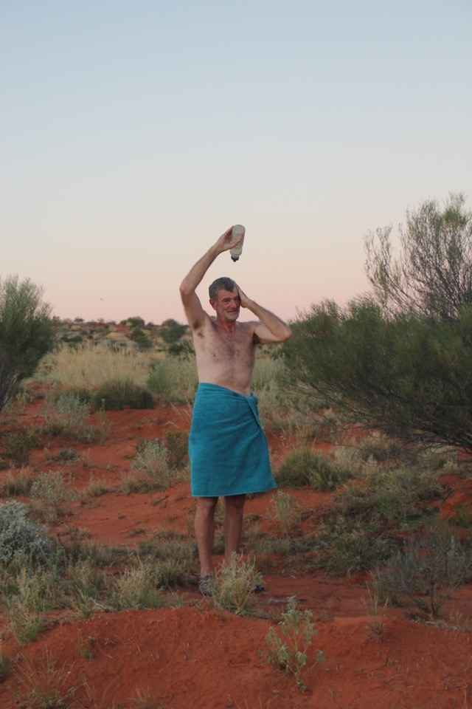
A shower with a view
Shower head on the HF radio antenna

Slide 12
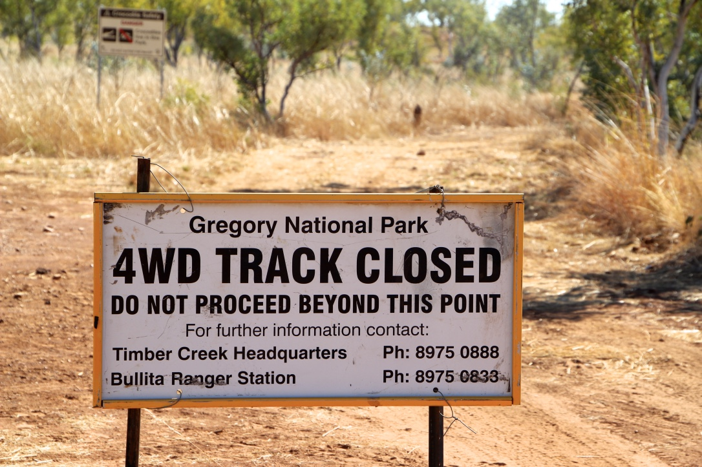
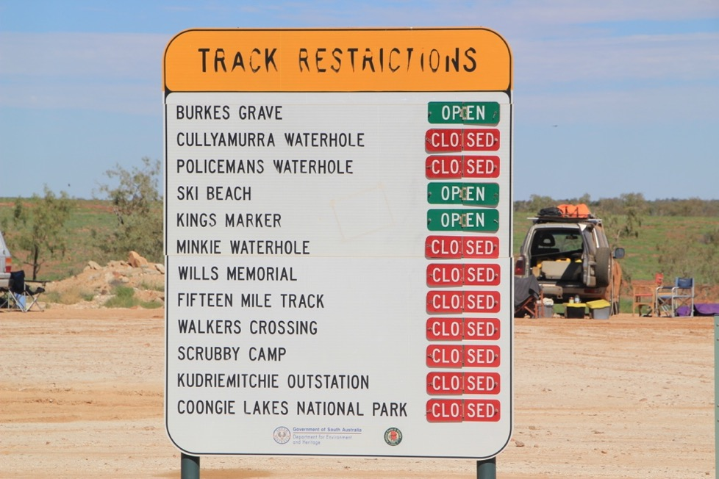
Preparedness & adaptability
Notes:
Plan, but be prepared to change. For the first two weeks we were constantly blocked by closures due to rain. Had to make major changes to our route three times. Added about 1000km… But we saw some interesting places we hadn’t expected to.
Bogged in the middle of the Strezlecki Track. Unable to get across Cooper Creek (Only place two rivers – the Thompson and Barcoo – join to become a creek) or the Warburton River
Fun and games avoiding the worst of the mud across the Simpson Desert. Parts of the track still flooded three months later on the return journey.
Held up for 2 days in Geraldton. Drove all day in about a foot of water through Coolcalalya to get back to Boolardy. 300km diversion near Onslow. Unable to get to Mount Augustus, Australia’s largest monocline. Two days spent waiting for the Munja Track to dry out.
Weather info from operators of “Scheduled sessions” on volunteer-run Australia wide HF radio network called VKS-737

Slide 13
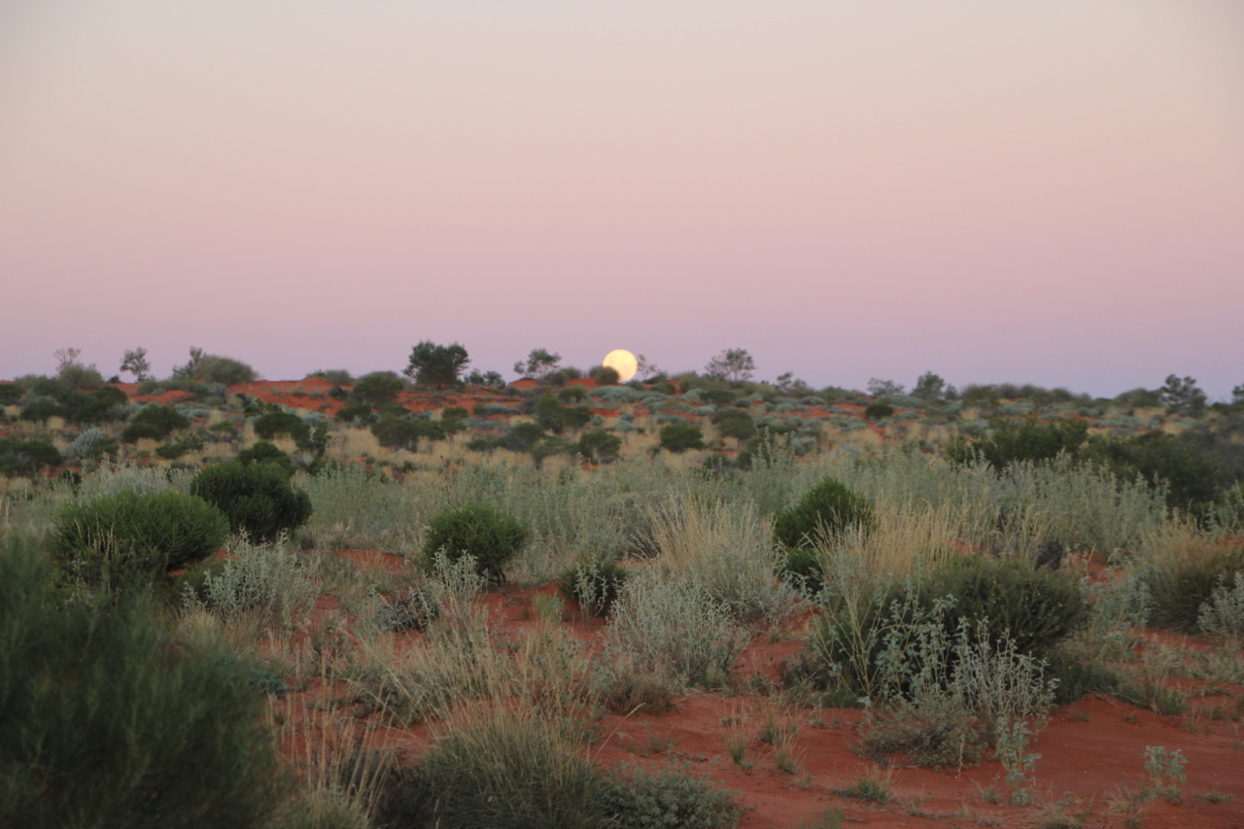
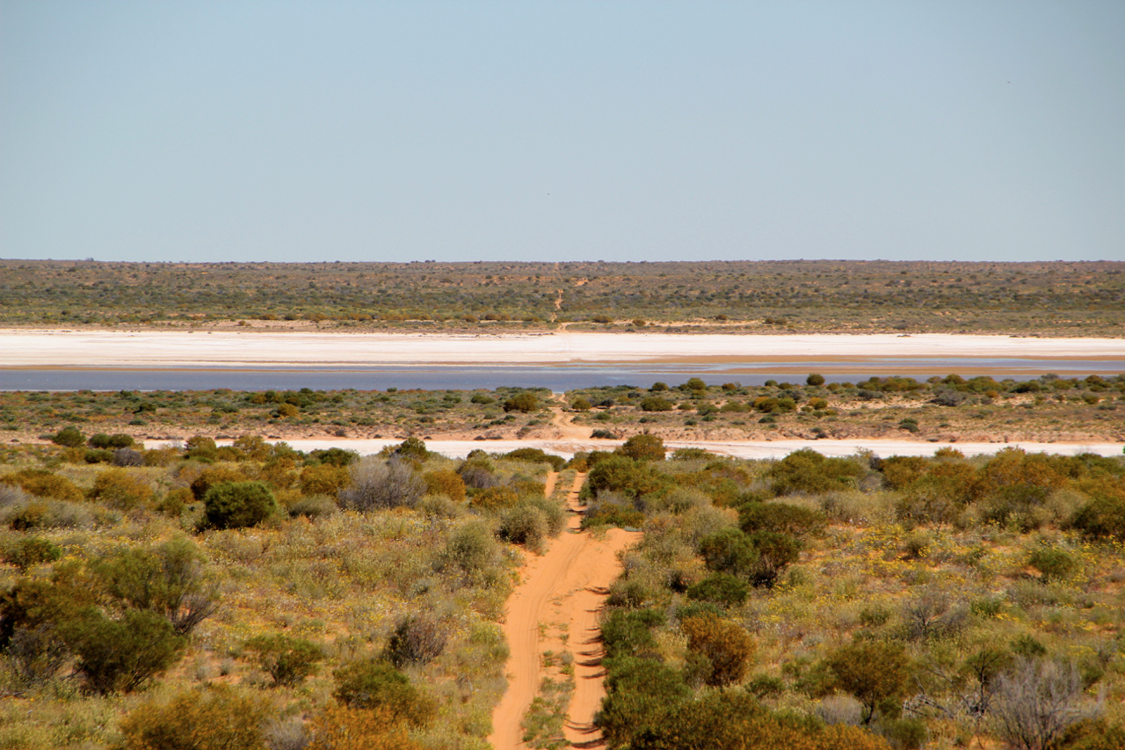
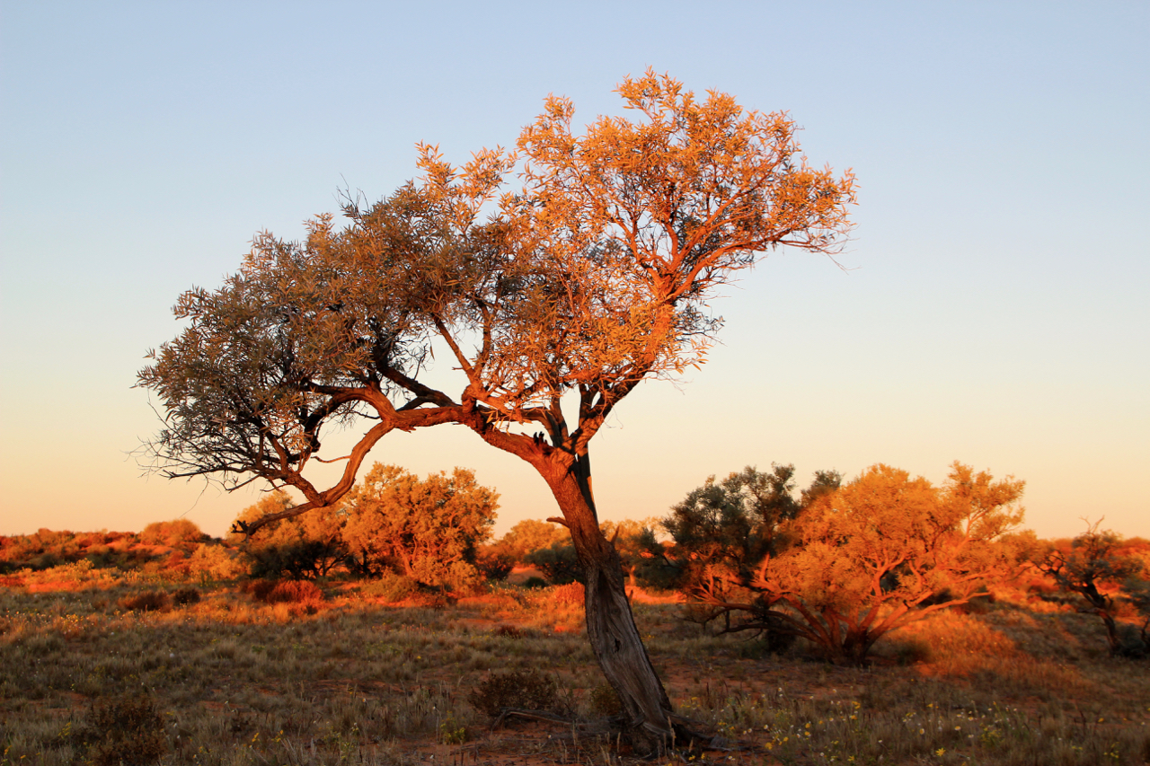
The Simpson Desert
An iconic 4wd trip
600km across
1100 sand dunes
3 parallel tracks

Slide 14
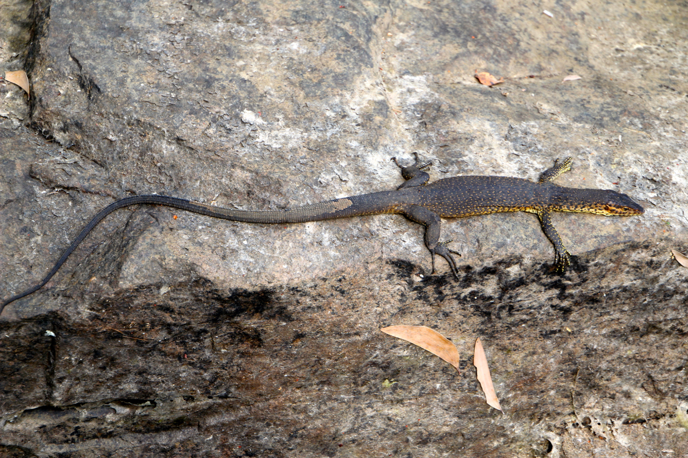
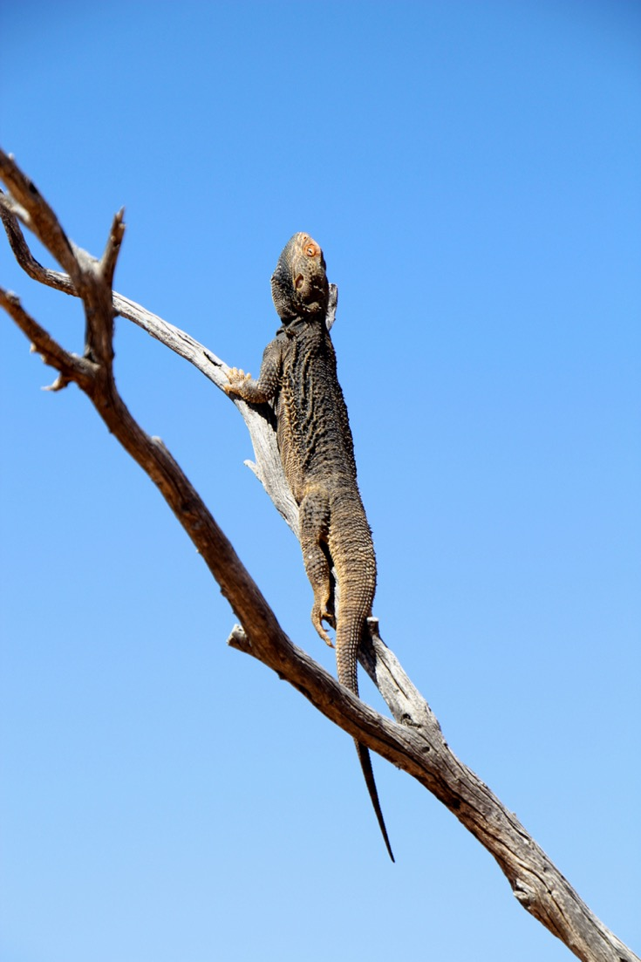
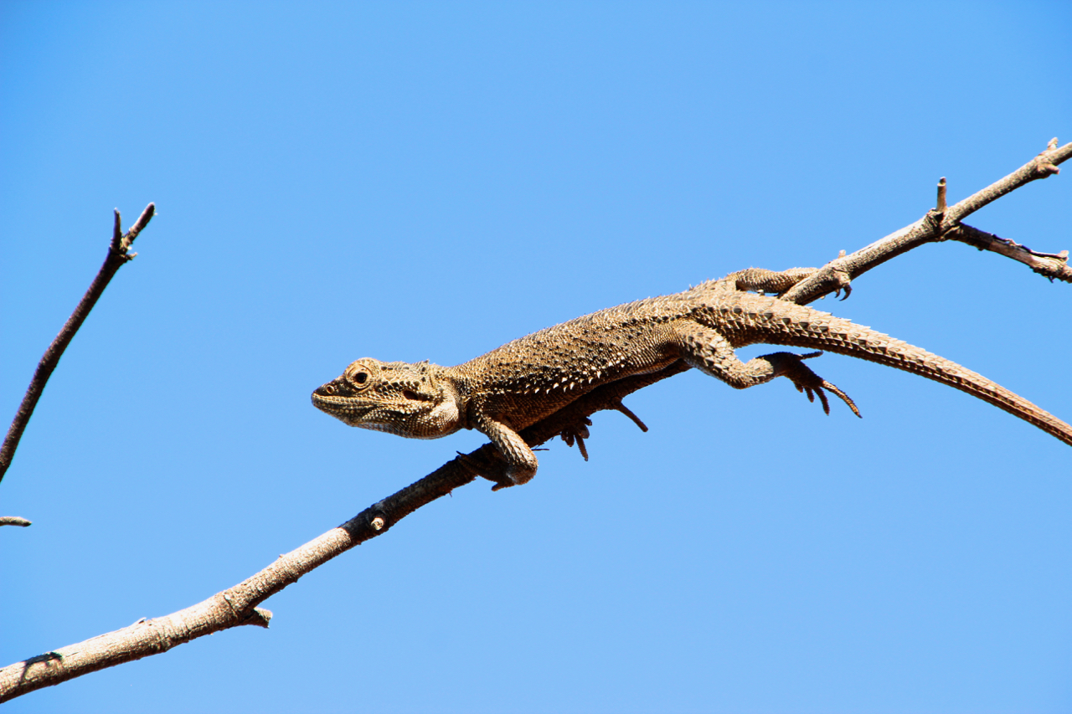
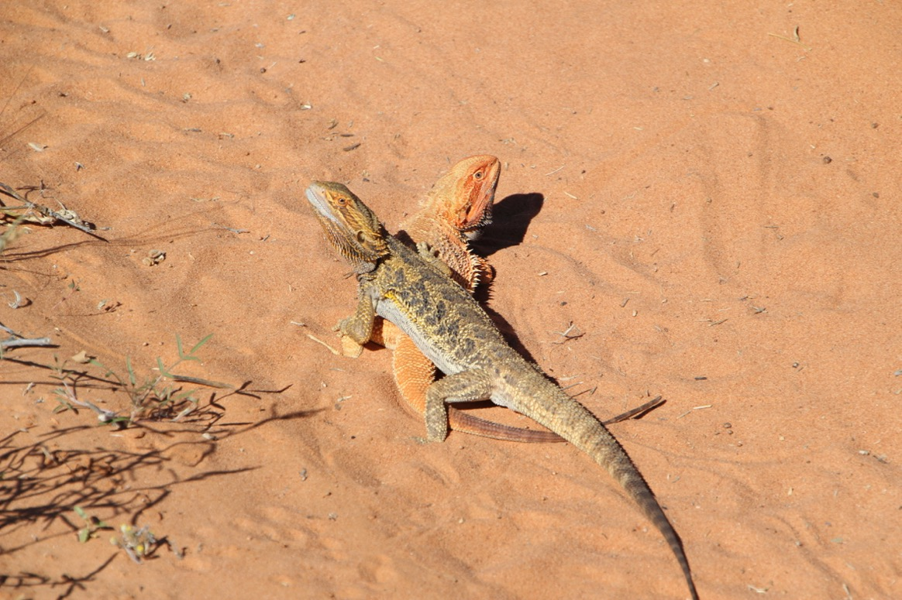
Some of the locals: 1
Notes:
Bearded dragons
Mertens water monitor

Slide 15
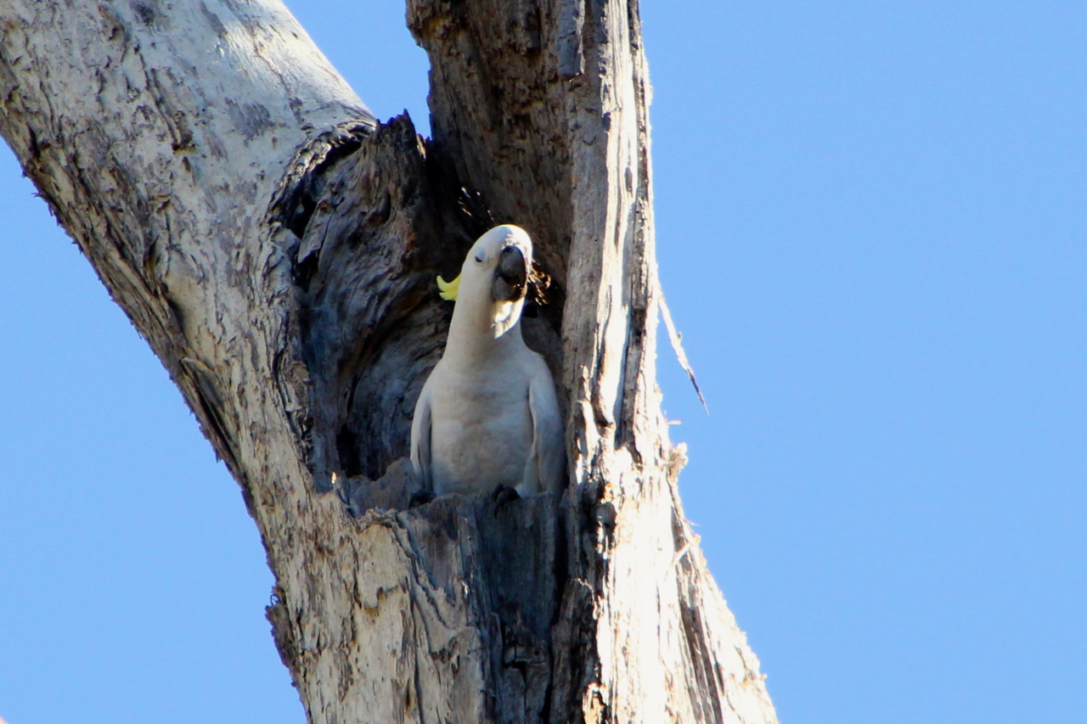
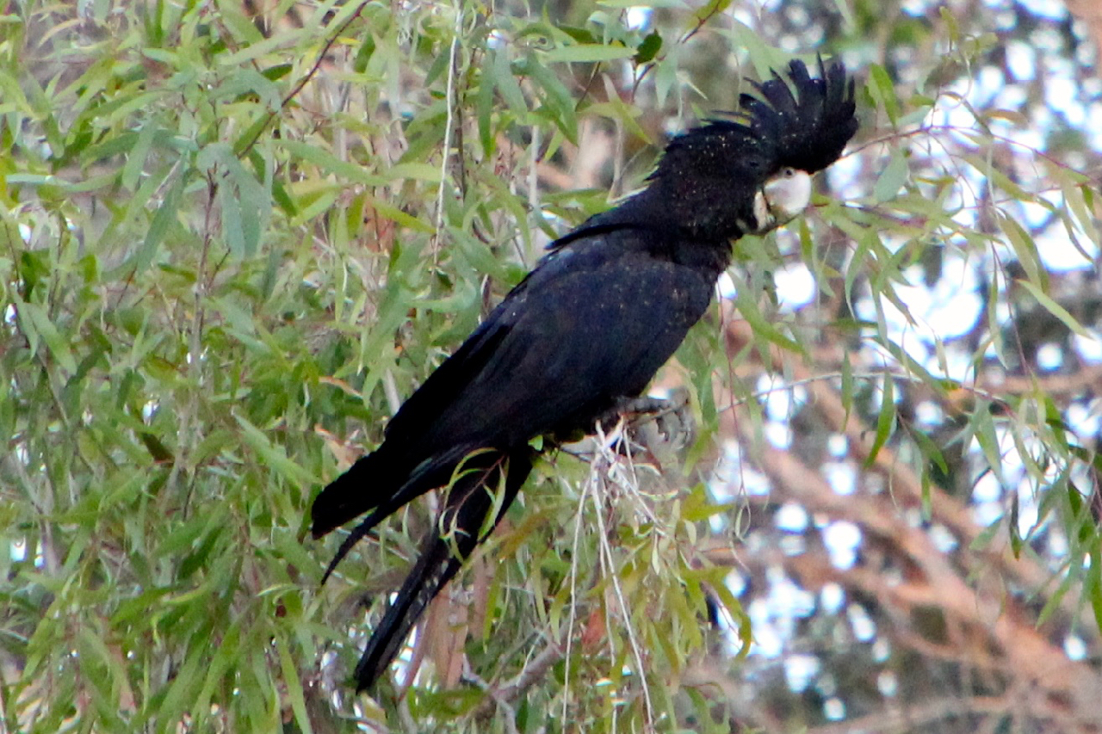
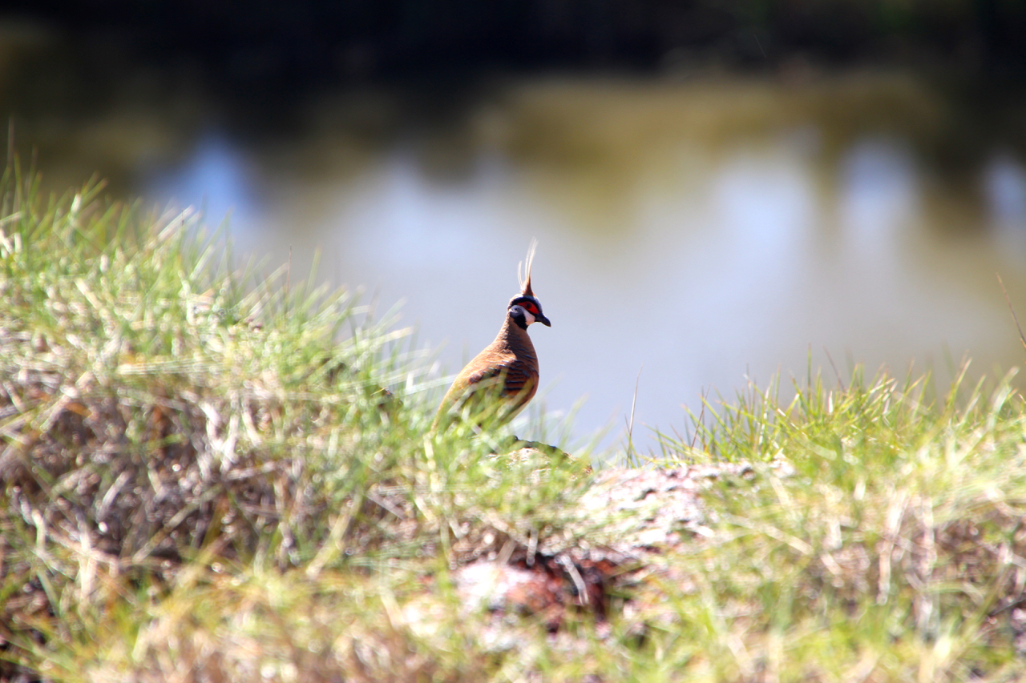
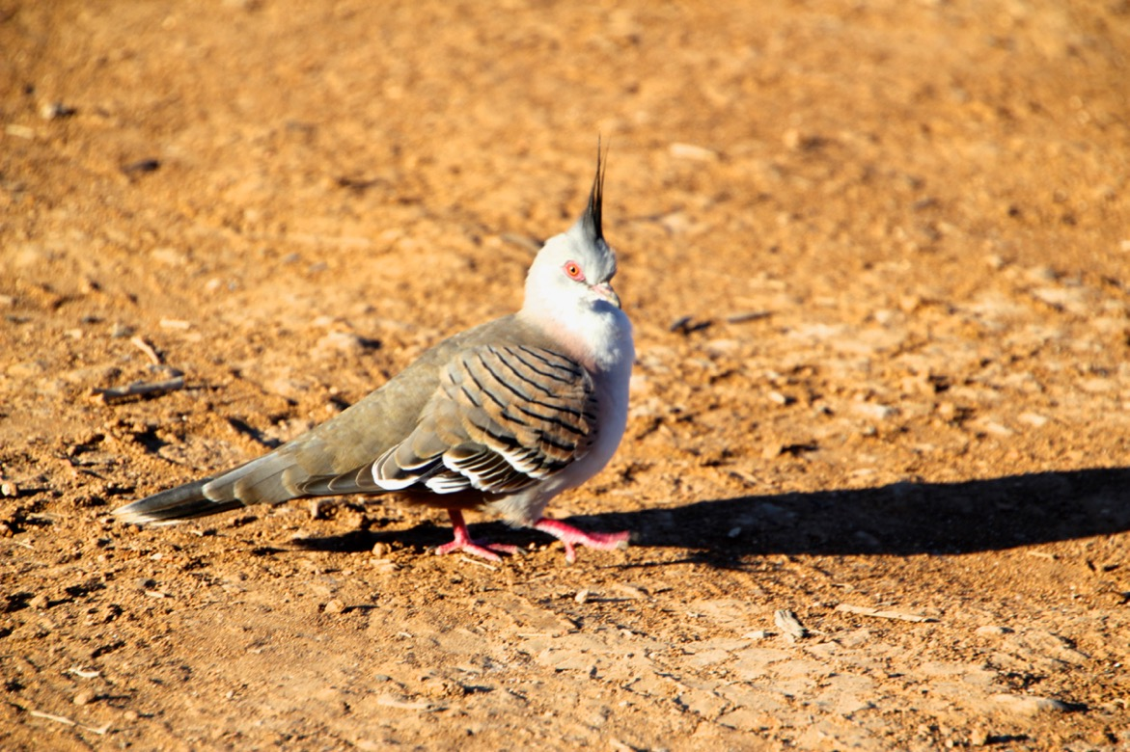
Some of the locals: 2
Notes:
Peaceful dove
Spinifex pigeon
Sulphur-crested Cockatoo
Red-tailed black cockatoo

Slide 16
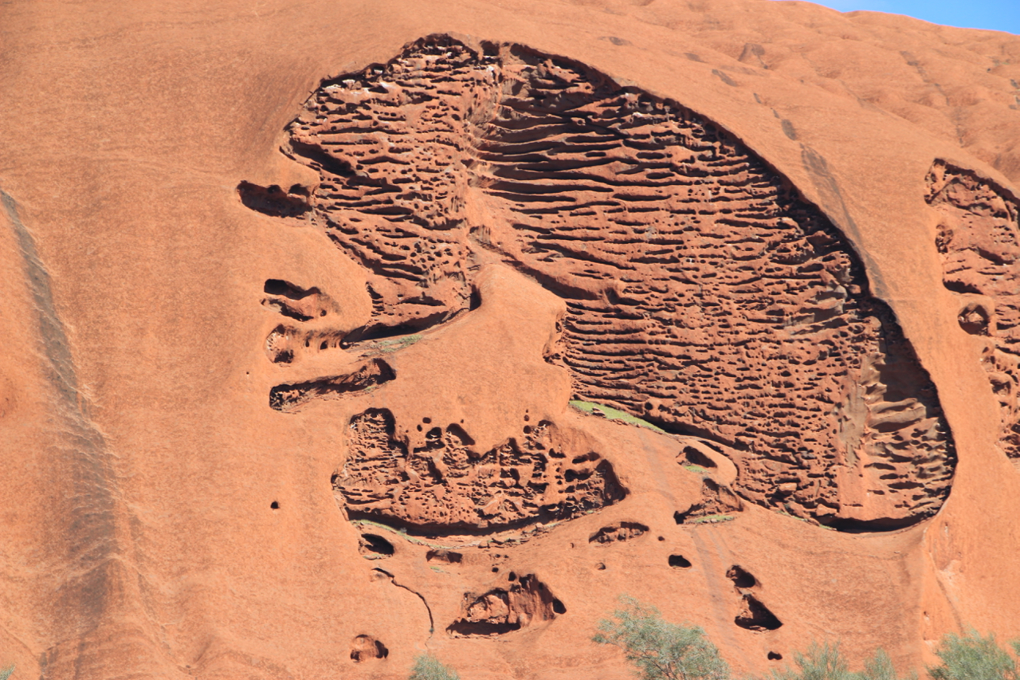
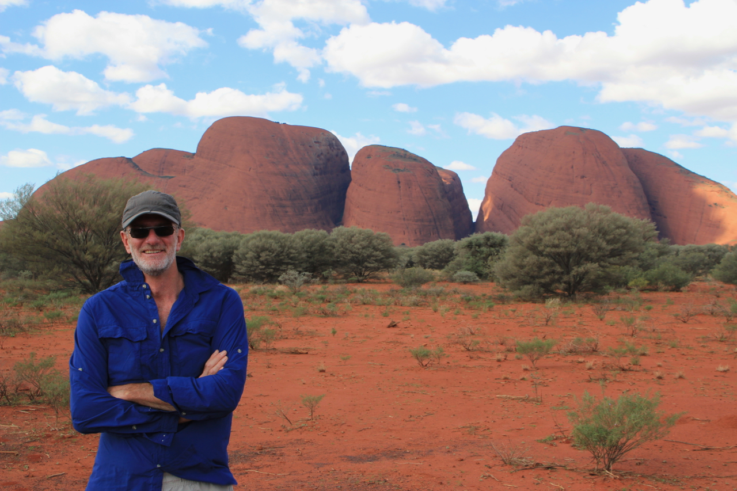
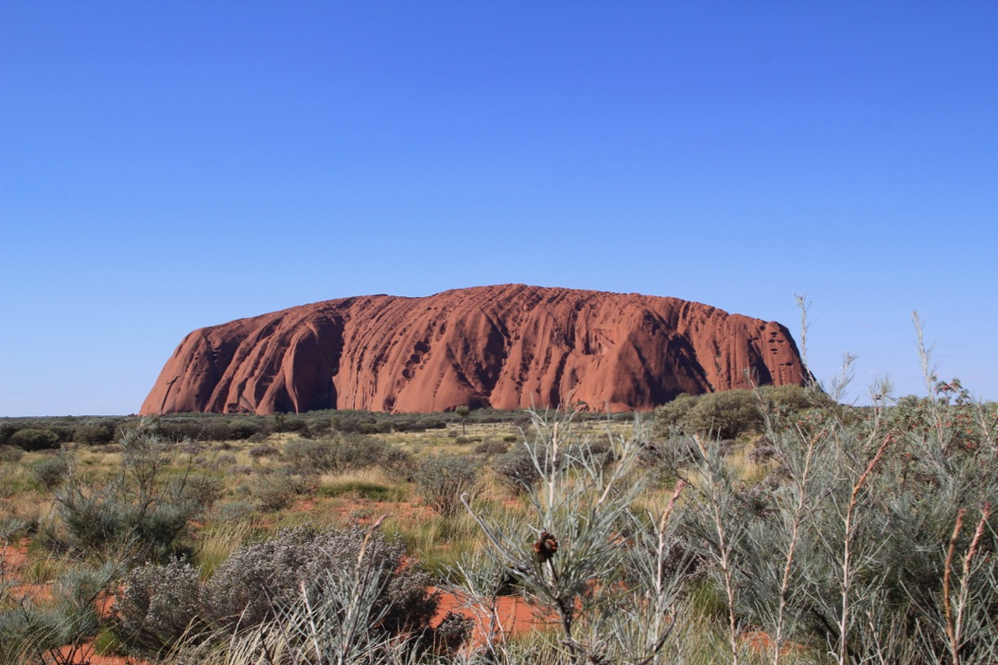
Recognize this?

Slide 17
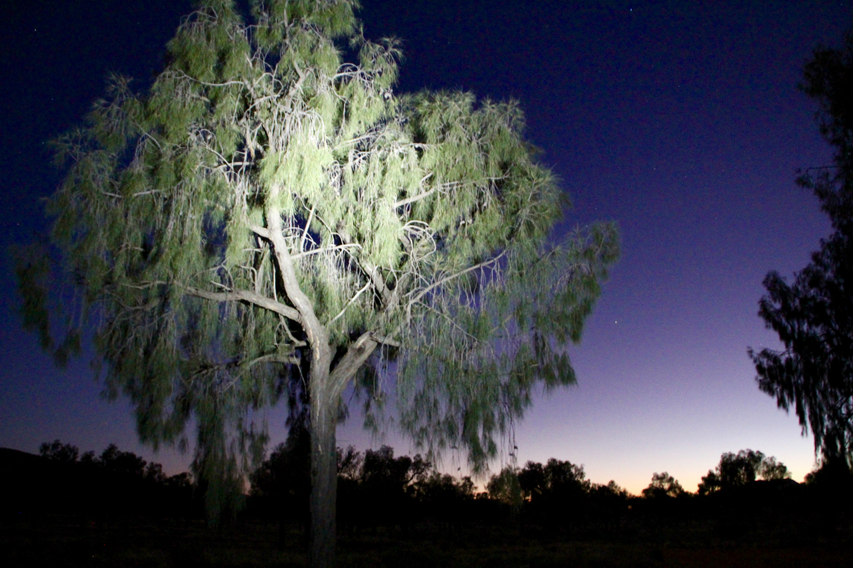
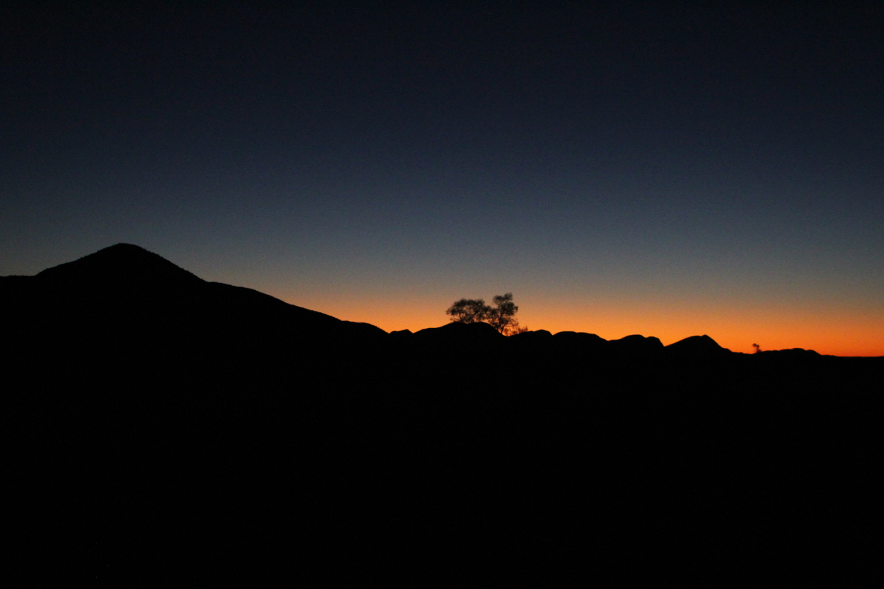
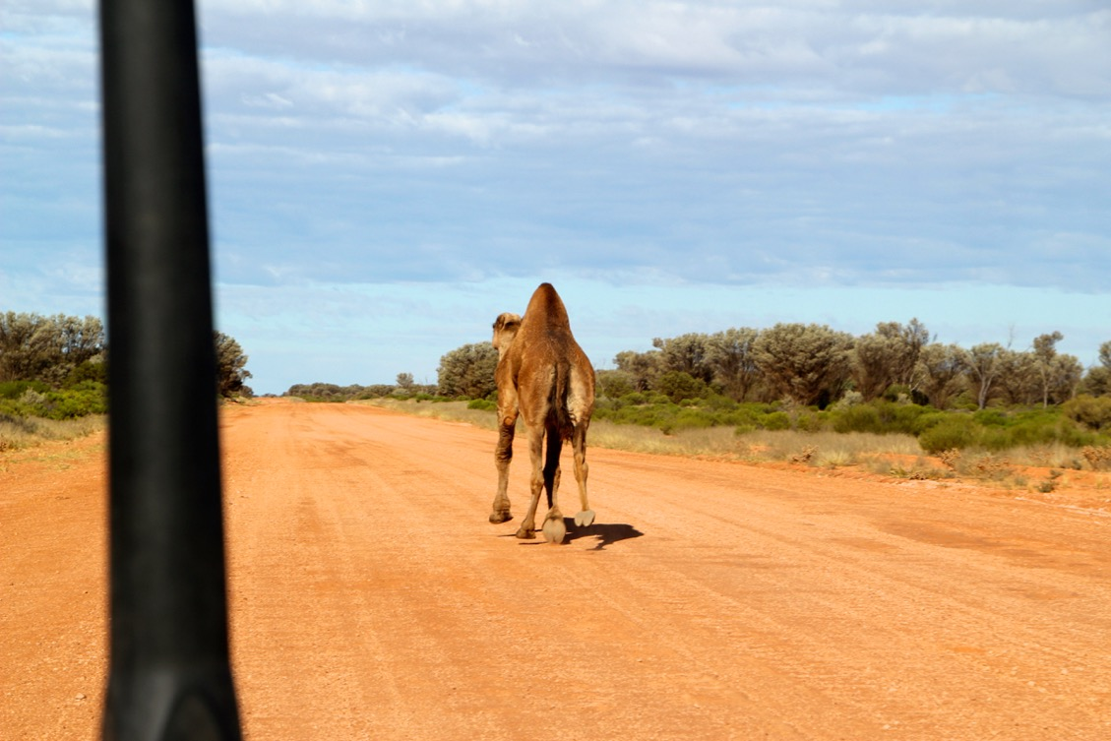
The great central road
Notes:
~1200 km long
all gravel or dirt
just 3 aboriginal settlements
but beautiful and surprisingly fast

Slide 18
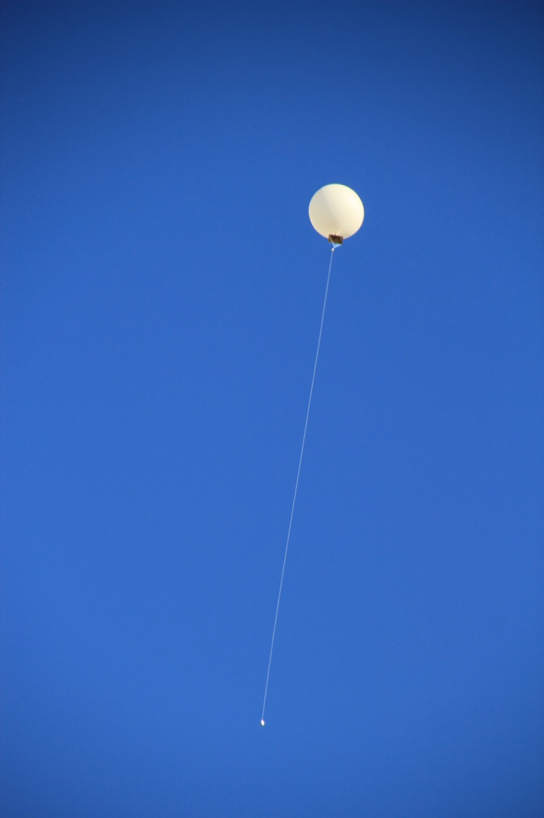
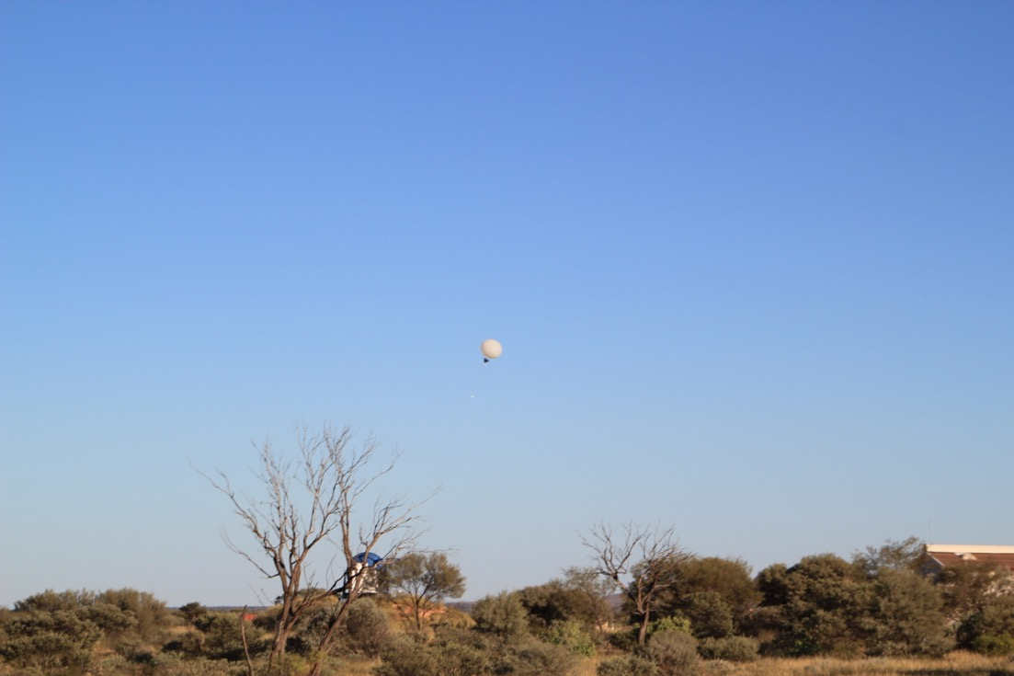
Giles Meteorological station
Weather station set up by Weapons Research establishment
to measure winds as part of British atomic testing
Surveying by Len Beadell
Notes:
The Gunbarrel Highway construction crew
Fantastic series of books from the 50s

Slide 19
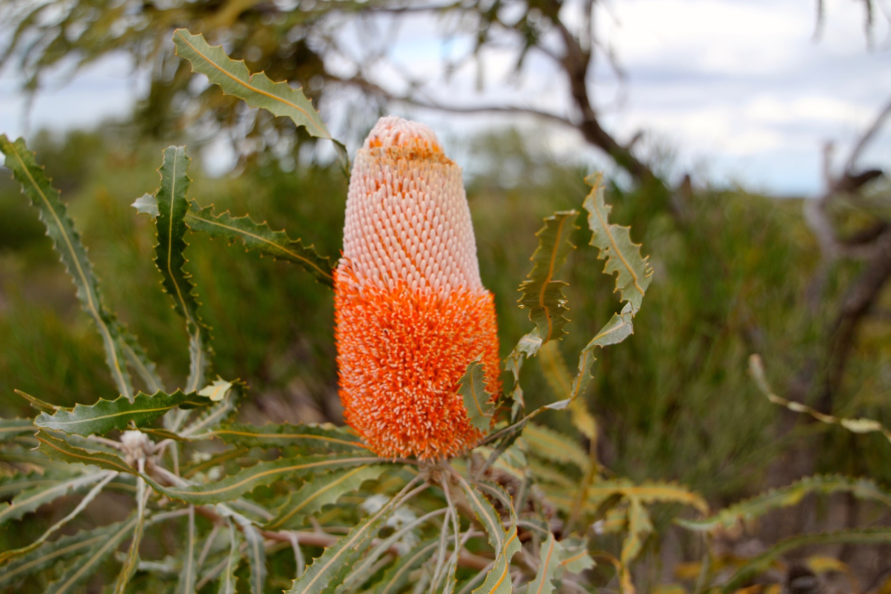
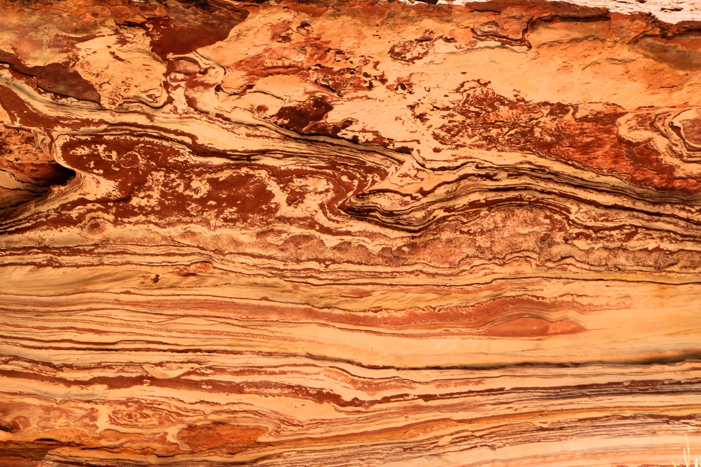
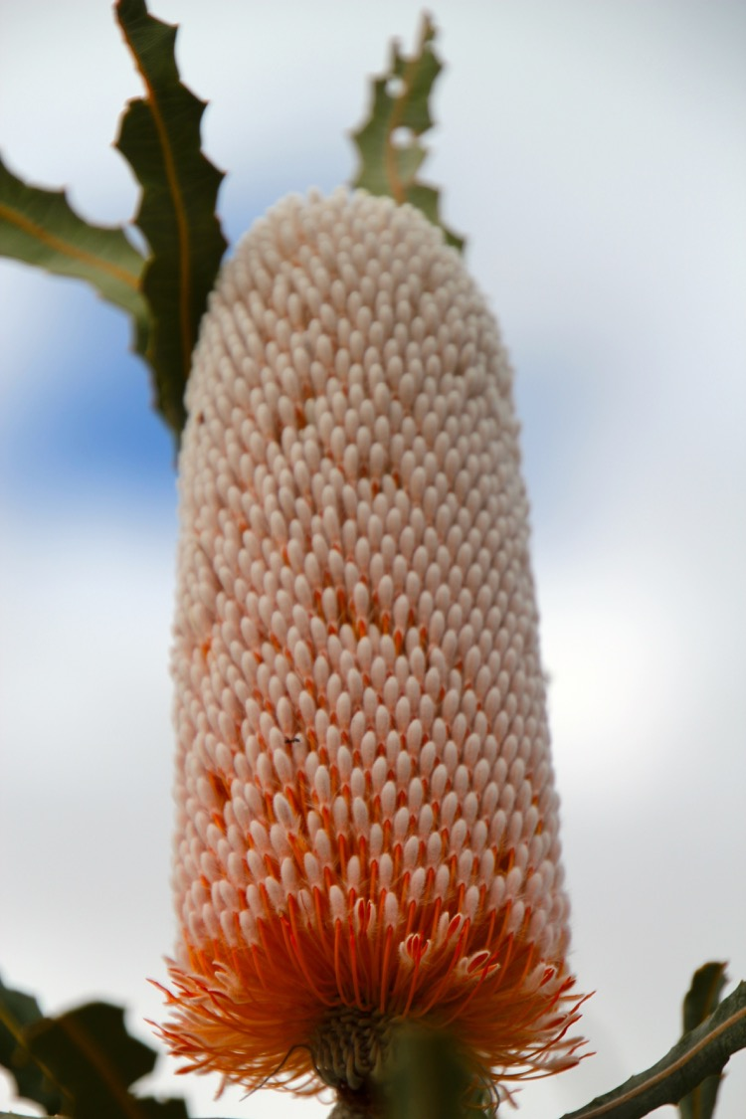
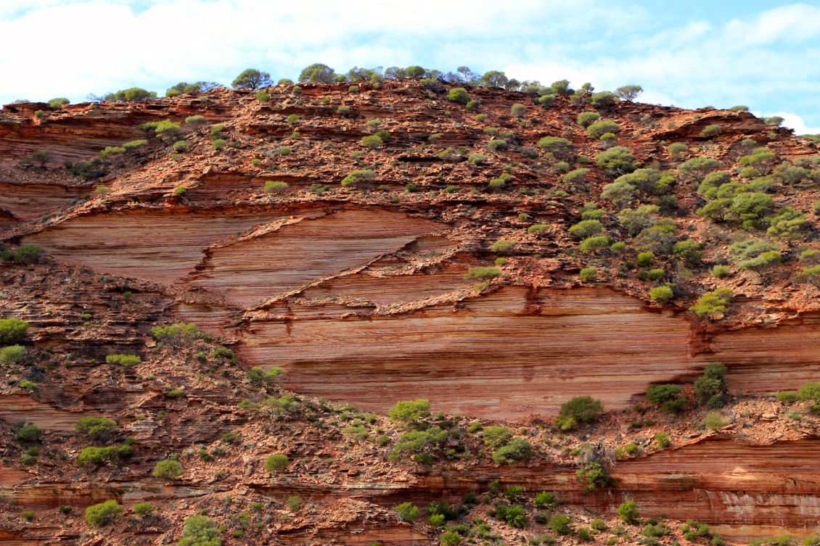
The murchison
Notes:
Murchison Gorge
Spectacularly beautiful sandstone
WA is known for wildflowers, but very dependent on the season and highly-variable rainfall

Slide 20
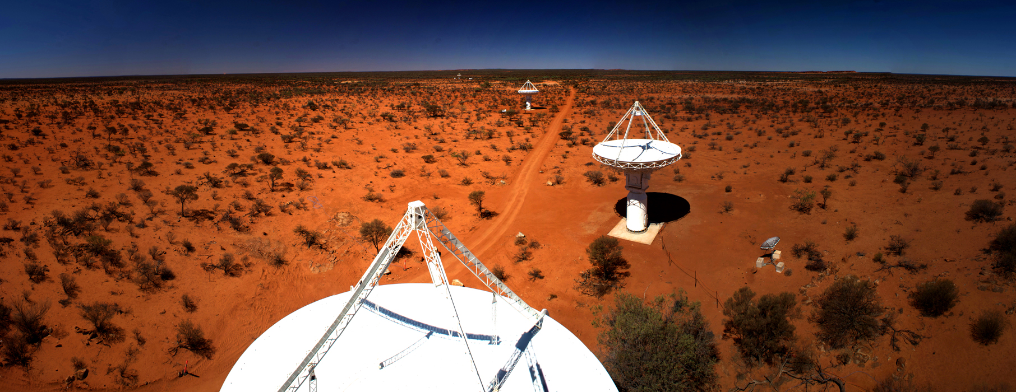
Boolardy and Wooleen stations
Notes:
Just like Mars but without all the water...
36 antennas, cm-wave survey telescope

Slide 21
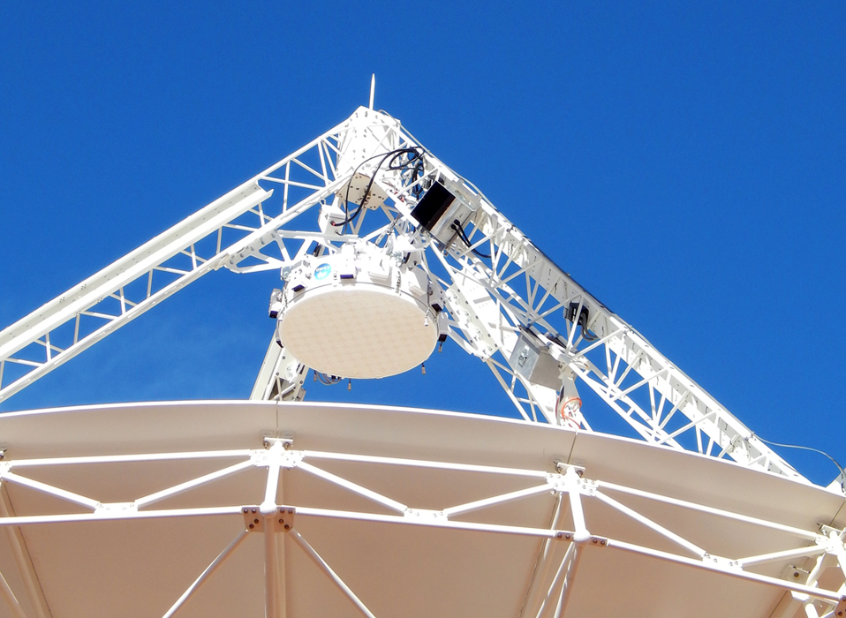
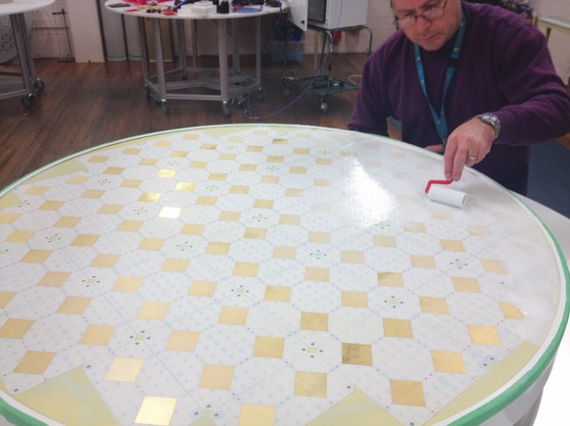
ASKAP & PAFs
Notes:
Innovative multi-beam receivers
Wide field of view with high resolution

Slide 22
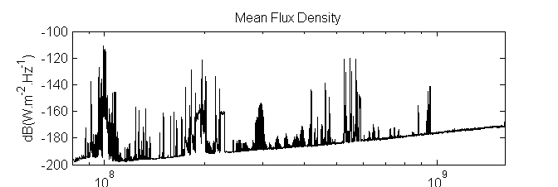
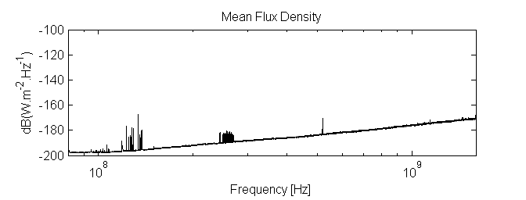
Why there?
Sydney
Pop. 4 million
One cattle station
200km x 180km
Human population 4
Population density 0.0001 / km²
Narrabri (ATCA)
Pop. 6,000
Murchison Shire
(Equal area MA)
Pop. 120 (and dropping)

Slide 23
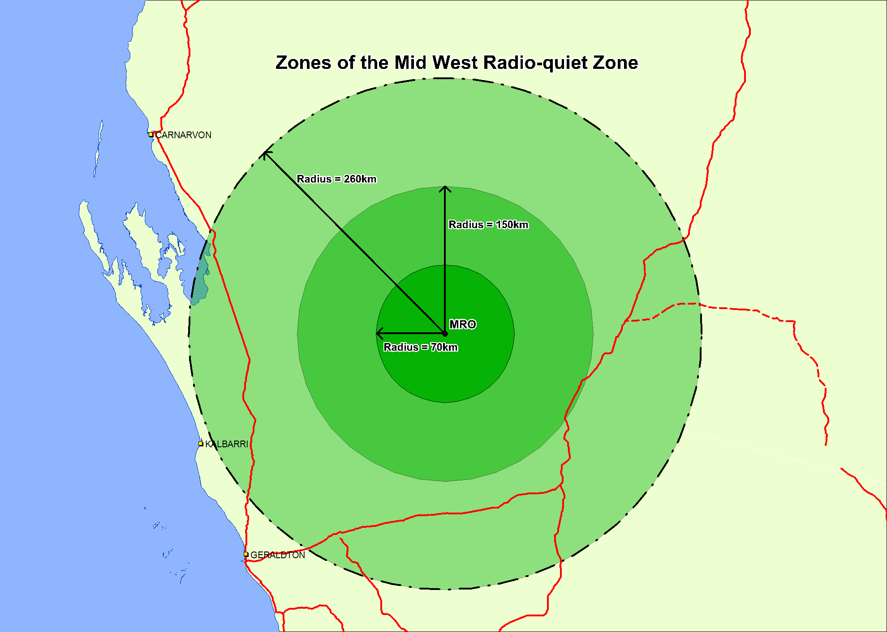
Mid-west RQZ
DC
GB
Notes:
If centred on Green Bank, would include DC!

Slide 24
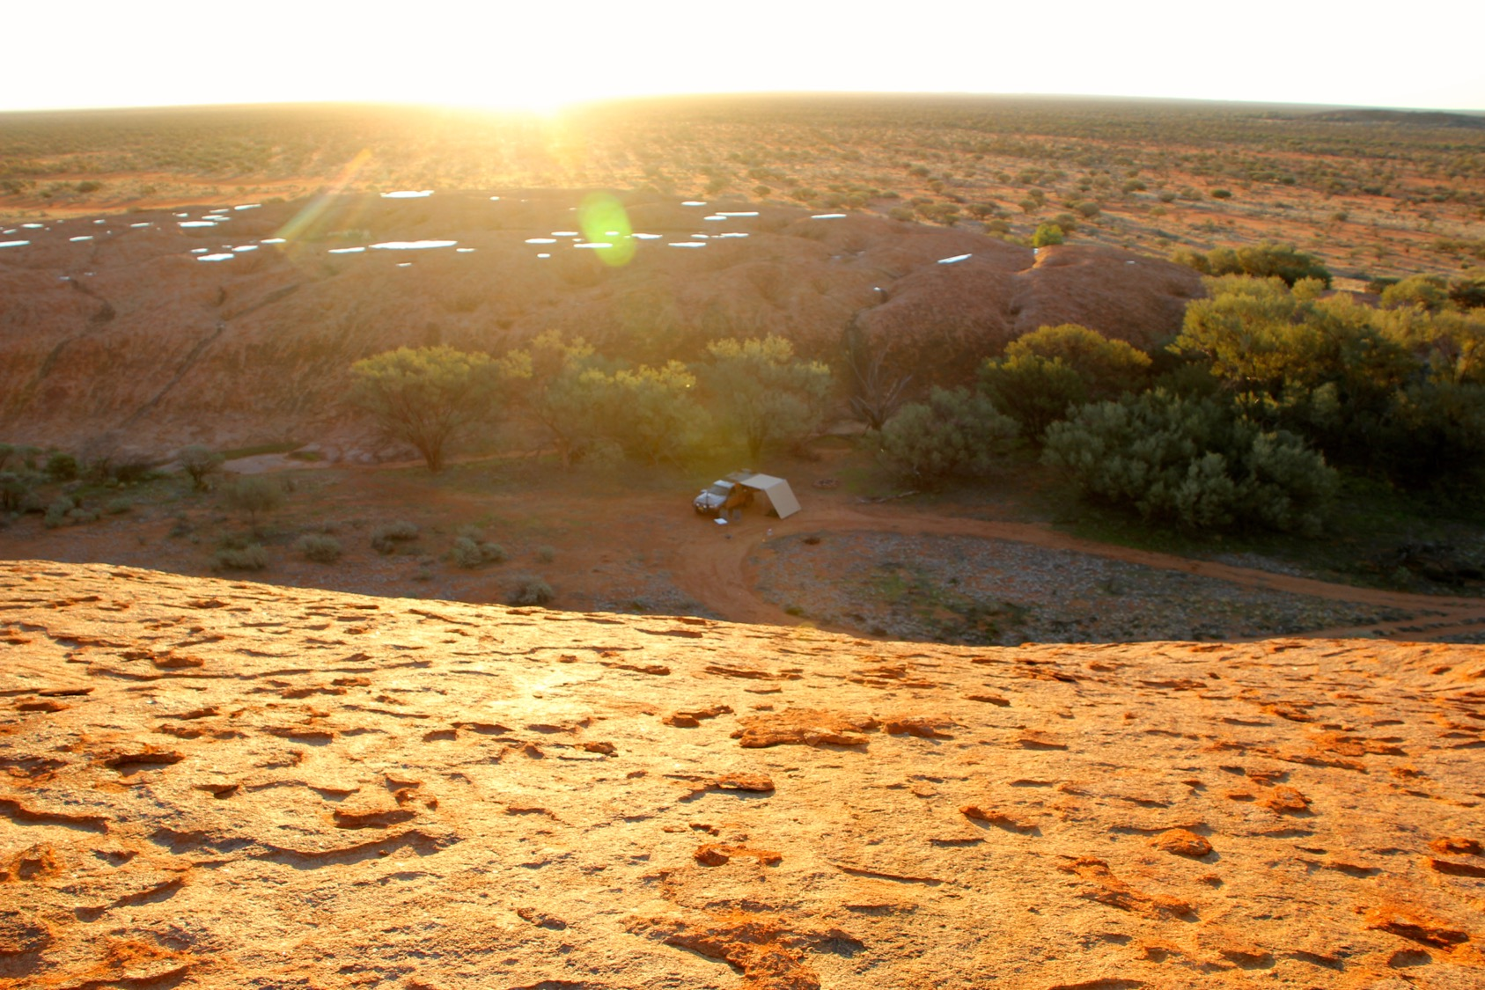
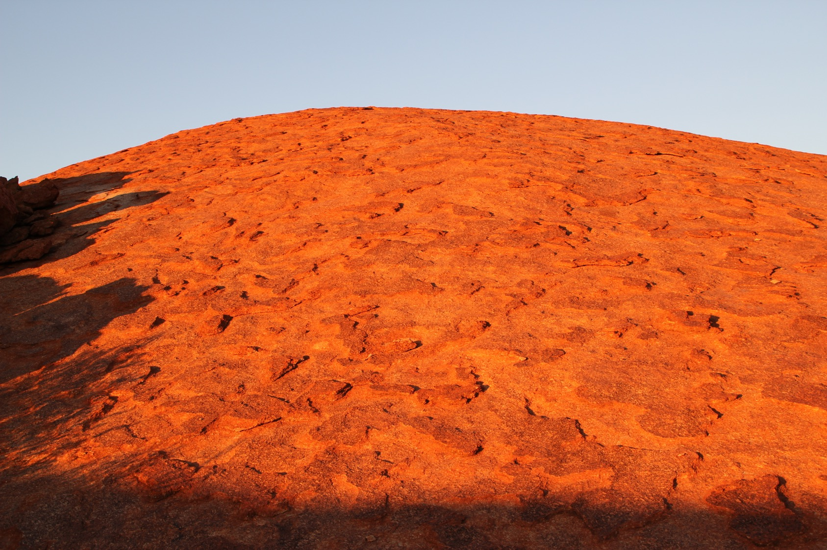
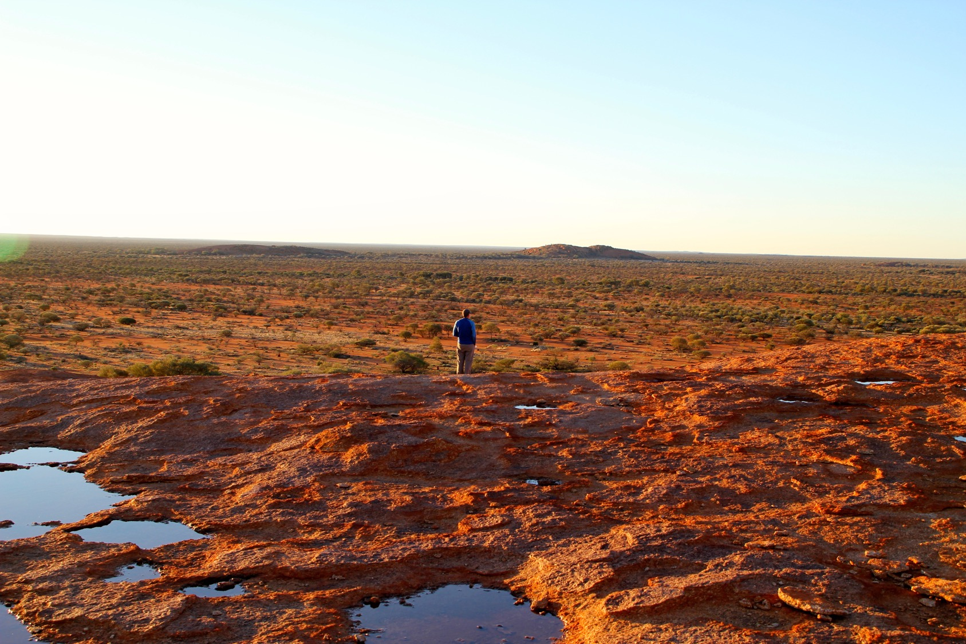
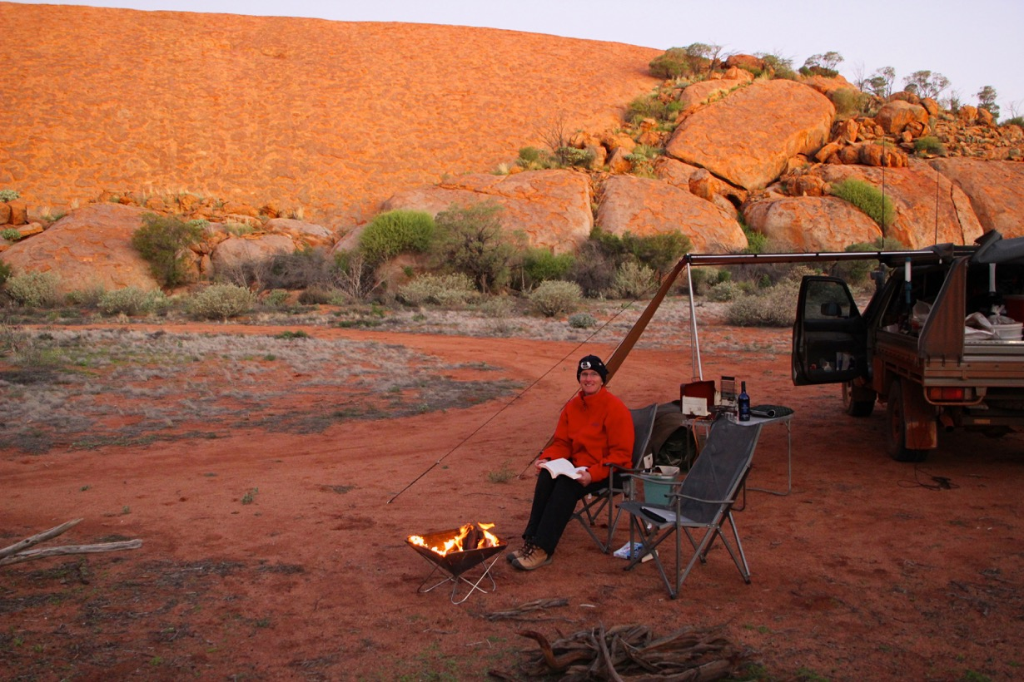
Wooleen.com.au
A small place 250,000 acres
Population 2-4
Sustainable grazing
A campsite surrounded By 3.4 BYO granite

Slide 25
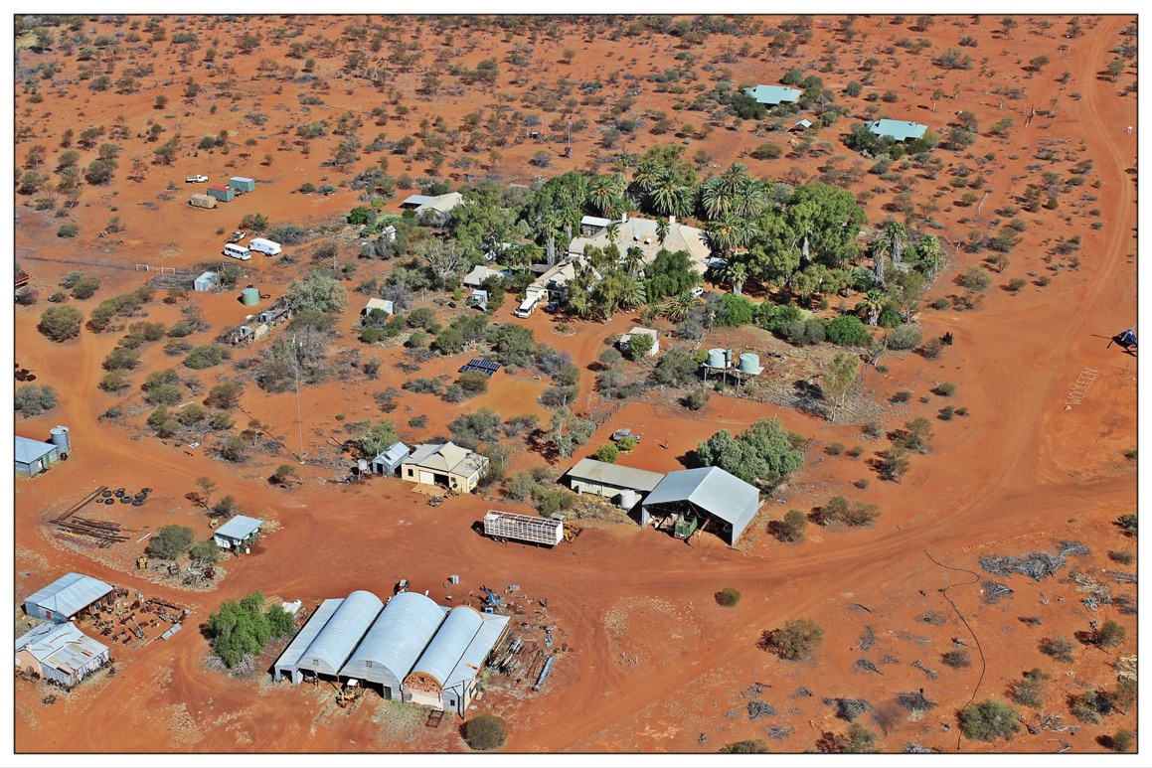
David and Frances

Slide 26
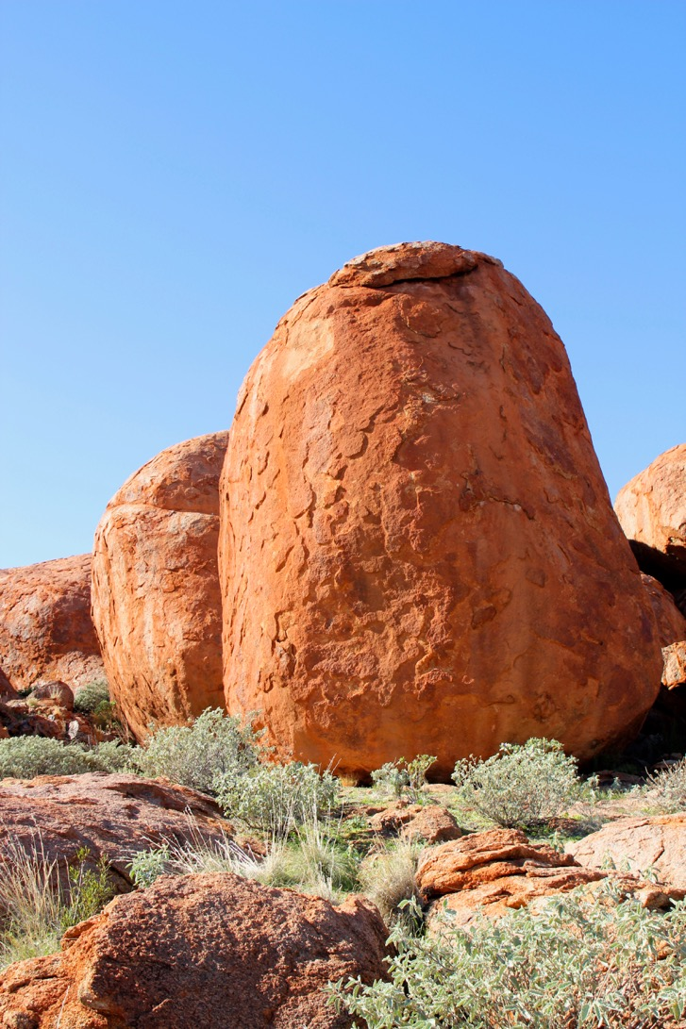
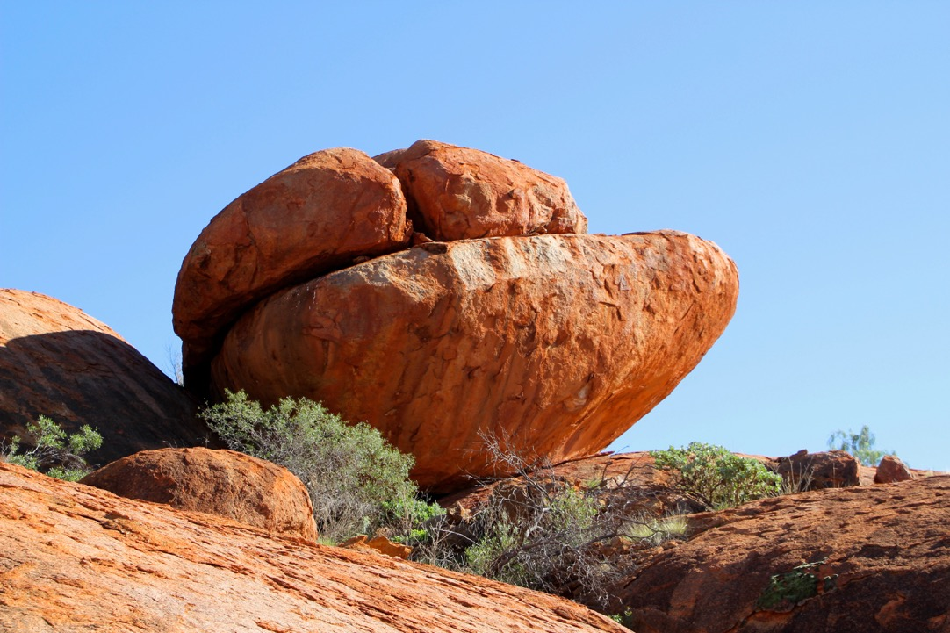

Slide 27
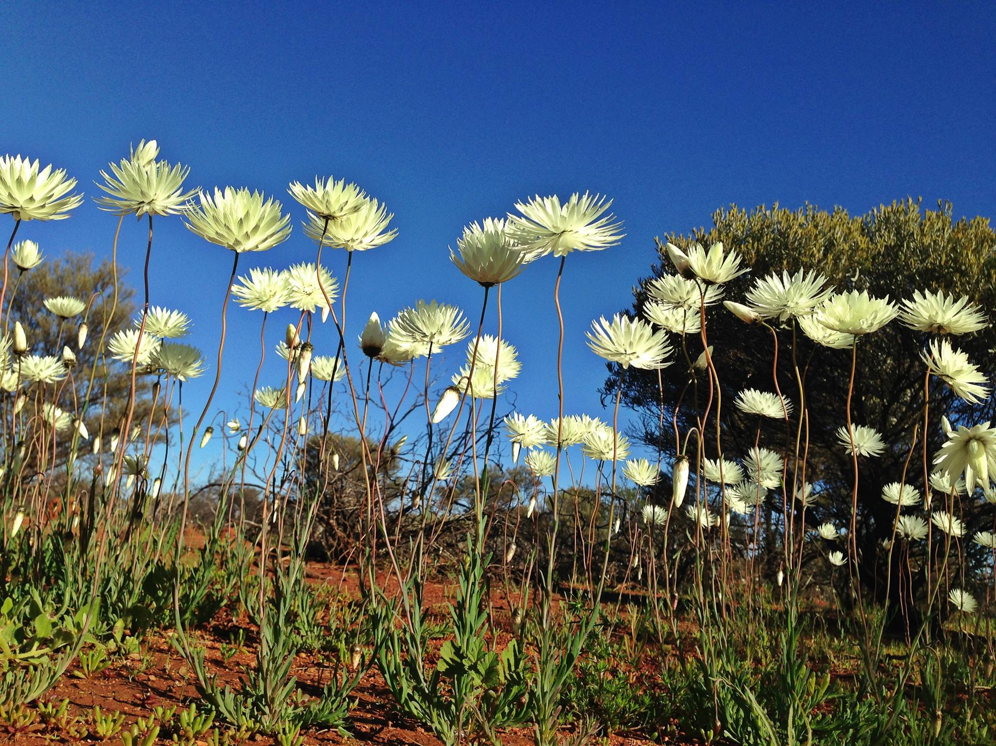
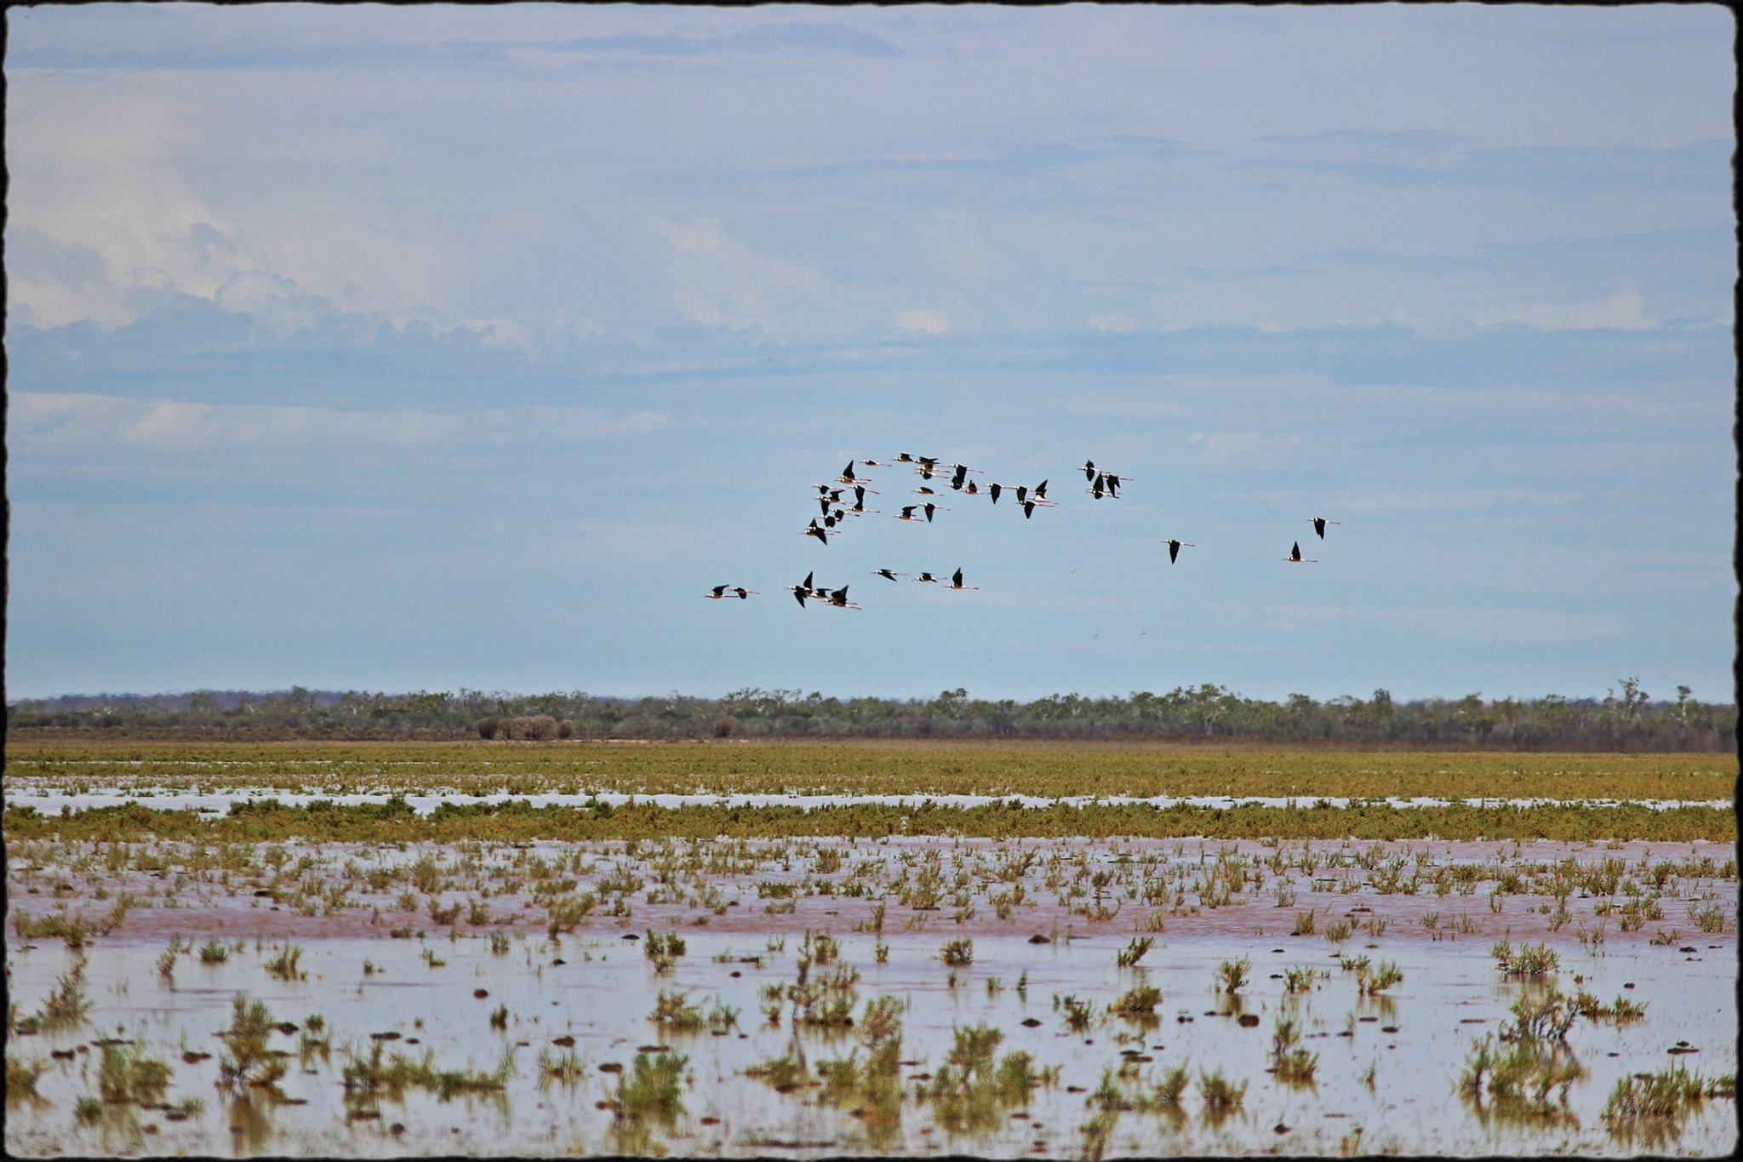
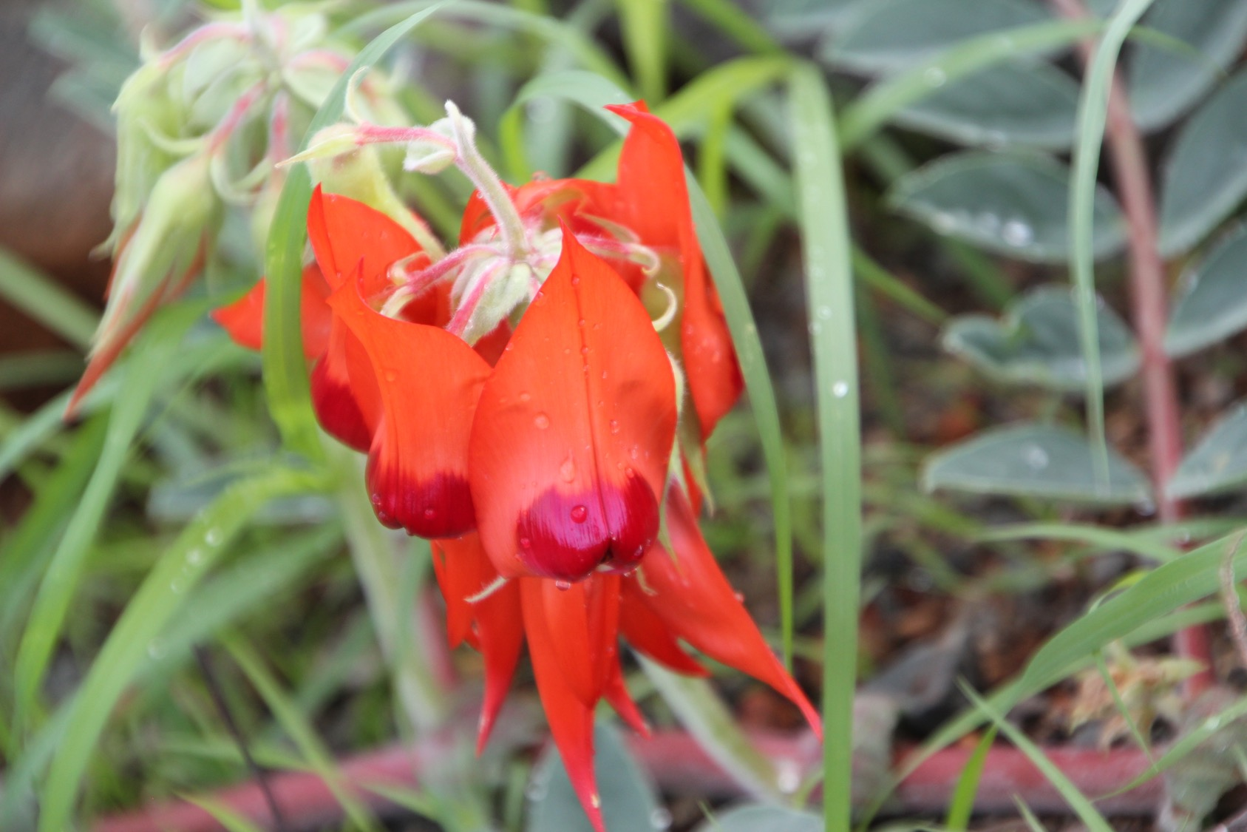

Slide 28
World heritage coast
Notes:
Where the red desert meets the sea
Spectacular remote beaches
Reminders of the need for self sufficiency

Slide 29
Petroglyphs
Notes:
Relatively common in the NW
Dampier Peninsular is one of the most significant petroglyph sites in the world
Tens of thousands...
Occasionally find them completely unexpectedly too

Slide 30
The Munja TracK & Bachsten Bush Camp
Notes:
220 km private track
145 km from Mt Elizabeth to Bachsten Creek Bush Camp
2 day wait to dry out from rain
7 hours to drive to the camp
Open for ~3 months / year – rebuild creek crossings after the wet season (June) and run away from the march flies (September)
Caretaker couple, ~3 primitive huts, ~10 campsites, a wood fired donkey boiler, and a stunning location
Bush air strip 4 hours drive away (further along the track)

Slide 31
Mud Map #1
Notes:
The creek loop
Short-eared rock wallaby
Nabarlek - Pygmy rock wallaby

Slide 32
Mud Map #2
Notes:
Honeycomb rocks

Slide 33
The Red Light District
Notes:
Monjon, Kimberley rock rat

Slide 34
Campsite entertainment
Notes:
Golden bandicoot
Northern quoll
Nationally endangered, locally prolific

Slide 35
Indigenous art
Notes:
Stimsons python

Slide 36
Different styles

Slide 37
Newhaven Sanctuary
Notes:
Australian Wildlife Conservancy (Birdlife Australia) – privately owned
Newhaven – former cattle station
650,000 acres (250,000 ha)
18,000 miles² (or 46,500 km²)
135 miles x 135 miles (220 x 220 km)
AWC manage 11.63 million acres (4.65 million ha) across Australia

Slide 39
Burrowing Bees

Slide 40
First Dog
on the Moon

Slide 41
Notes:
28 miles (44 km) fence
25,000 acres (10,000 ha)
Plan is to double the area protected in 2020, adding another 185 miles (35 km) of fence…
Kill and exclude cats
Protect – 11 critically endangered species including mala (rufous hare wallaby), bilbies, numbats, western quolls, golden bandicoots, black-footed rock wallabies…

Slide 42
Other trips
The Kimberley
Cape York
Canning Stock Route
The Pilbara
Red Center
SW QLD
The Goldfields
Limestone Coast

