Slide 1
Alt-Text, Context, and Image Accessibility
Jennifer Arnott : June 2024

Slide 2
Hello!
I’m Jennifer Arnott
Research Librarian at Perkins School for the Blind since 2015.
Answer questions from Perkins and around the world.
Presentations (with my Archives colleagues) about making materials more accessible.
Previous life as a technology librarian.
Various personal online projects starting in 1994.
Notes:
Perkins serves students who are blind and deafblind, often with additional disabilities on campus, and also in the state, the region, and around the world.

Slide 3
Images online
So many places!
Different sites (all with varying tools and options)
Different contexts (formal writing, websites, social media, friends and family)
Generative AI tools are really bad at context or what’s important.

Slide 4
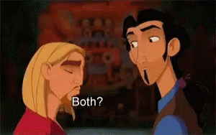
What is alt-text? Image description?
Alt-text is attached to a specific image.
Image description can be in the text or attached to an image.
Both give context to readers who need it Visual impairment, but also plain language, non-fluent readers, lacking specific context for humor or science. Also limited data, slow loading, remote areas.
Notes:
Still from an animated gif of The Road to Eldorado. The two characters look at each other, nod, and say "Both. Both is good."

Slide 5
A brief history
Alt text has been part of the internet since 1993.
Original goal: load text pages faster.
Became required for img and area tags in 1999 (HTML 4.1)
Often ignored, not taught, not explained.
Notes:
Anyone else here besides me online in the mid-1990s? I’m sure I’m not alone here.

Slide 6
Three kinds of image
Purely decorative
Essential information for understanding
Layered visual experience

Slide 7
Purely decorative image
Does not need alt text.
Mark it (in your software) to indicate that.
Example: Perkins logo in the bottom left of each slide. Describe it once briefly, ignore all the later ones.
Consider putting “null” if there’s nothing relevant.

Slide 8
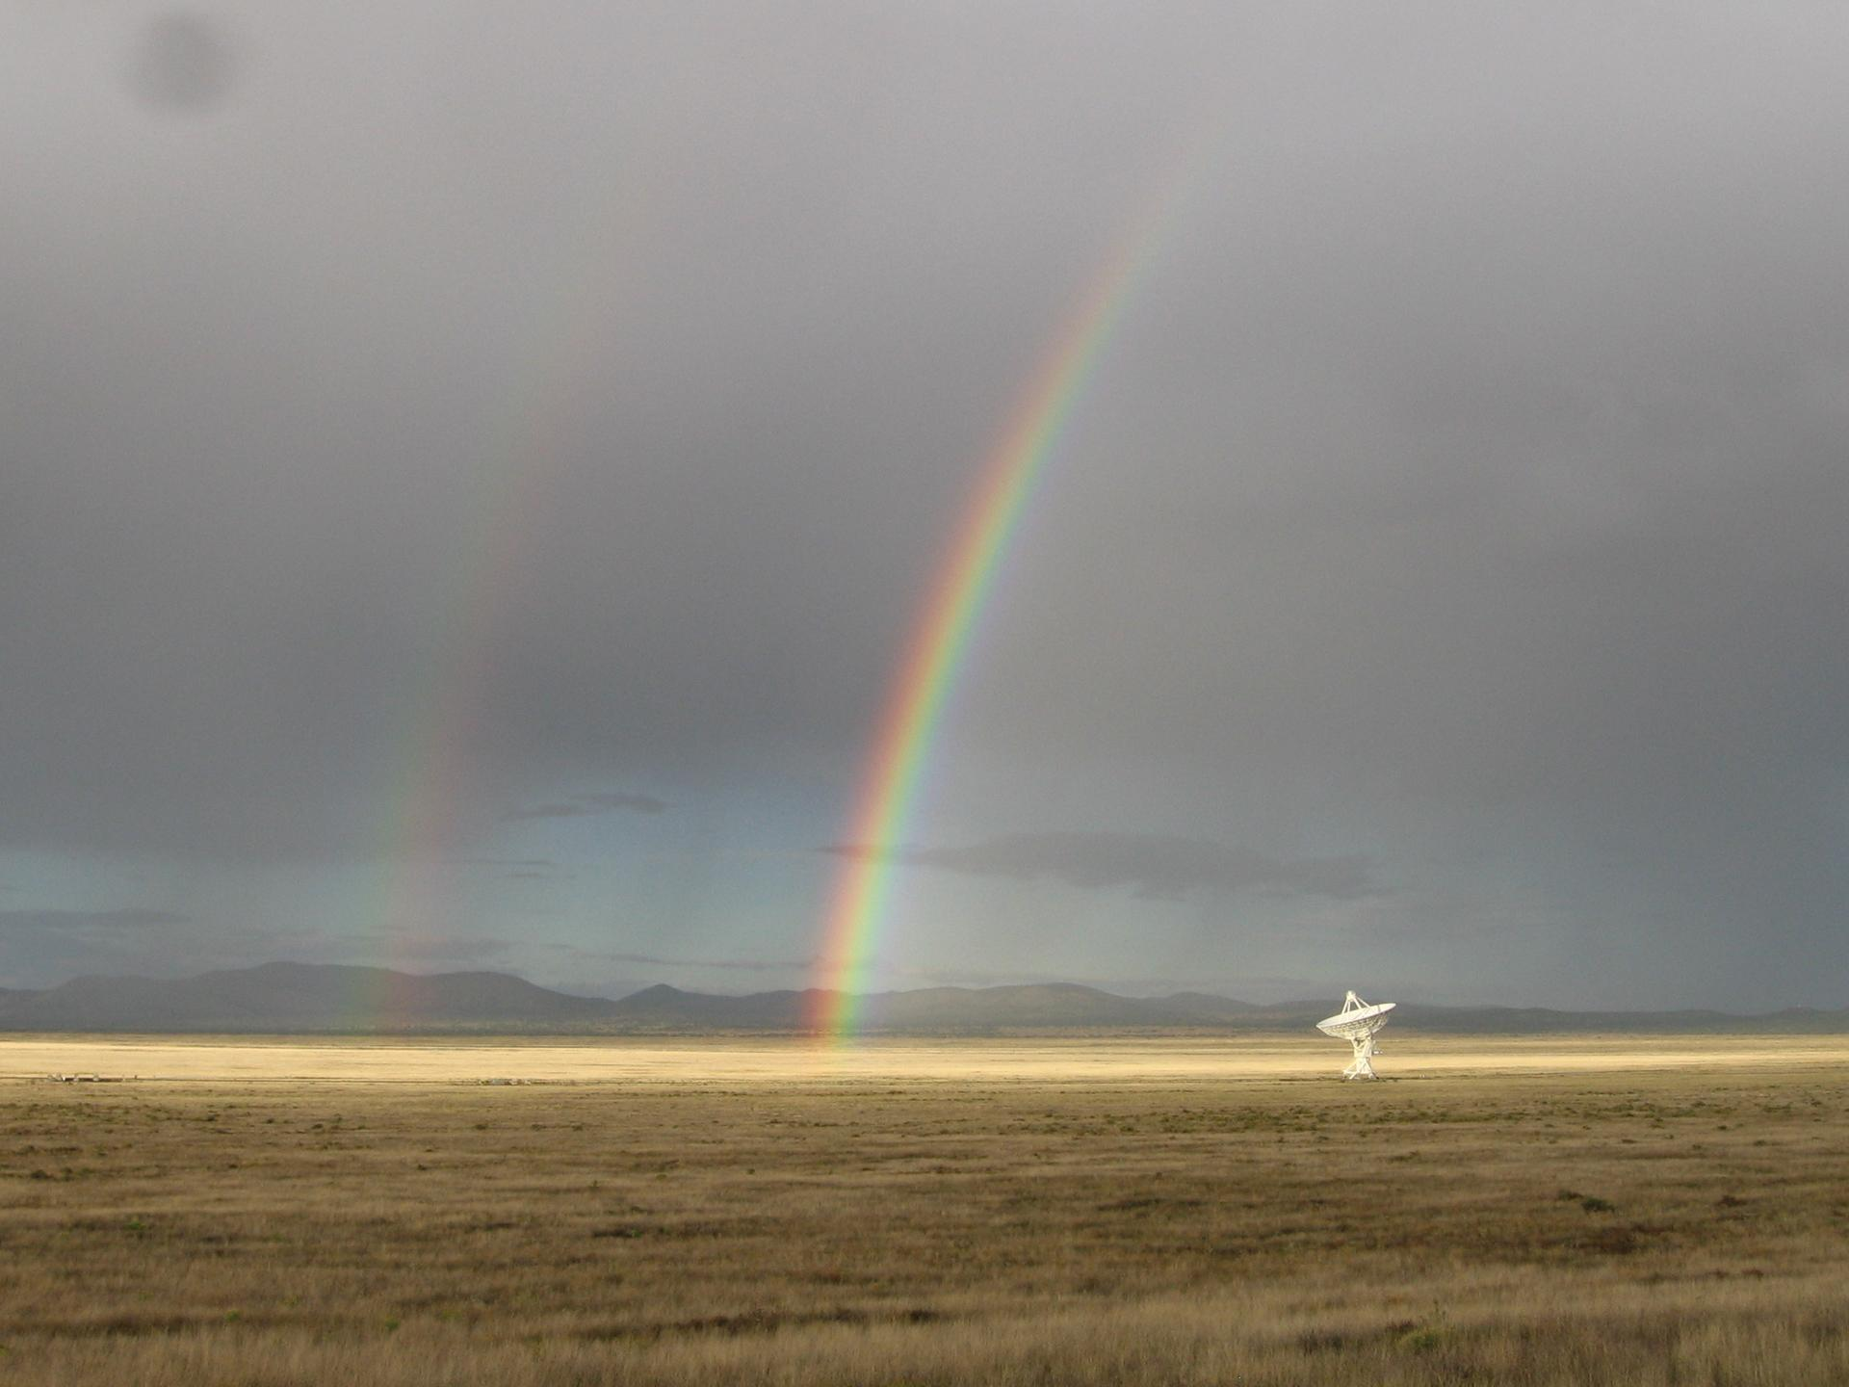
Visual information
Alt text provides key details in a brief format. What’s interesting?
What do sighted viewers learn from this image?
What do people using alt text need to know to make sense of it or why it’s included?
Credit: NRAO/AUI/NSF
Notes:
To borrow an image from your site, here’s the image of the week for June 1st, 2024. The description on this image’s page says “The Very Large Array may sit in the New Mexico desert, but it’s not always dry. Summer monsoons bring much-needed rains, and this lovely afternoon also brought a double rainbow.” which is honestly a great brief description.

Slide 9
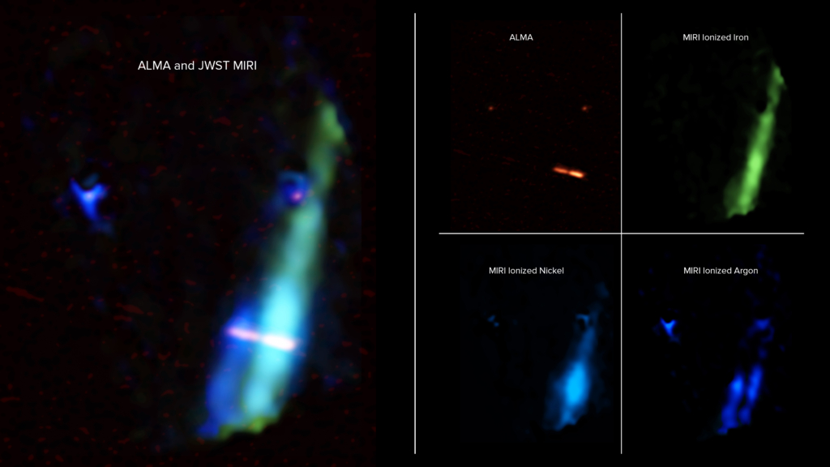
Layered visual experience
Art, complex images, charts and graphs, data, etc.
Needs a longer description and more context.
What people want in that description will vary.
Know your audience.
Credit: U.S. NSF/ NSF NRAO/ ALMA(ESO/NAOJ/NRAO)/ NASA/ JPL-Caltech/ JWST/ B. Saxton.
Notes:
Taken from https://public.nrao.edu/news/its-twins/, news release June 12th, 2024. These brightly colored shapes represent astronomical data collected by NRAO's ALMA and NASA's JWST telescopes. At left, a composite image overlaps ALMA and JWST data revealing the discs and parallel jets emitting from the pair of binary stars in WL20. At right, the breakdown of the separate ALMA data, and JWST data representing various chemical compositions, is shown.
Credit: U.S. NSF/ NSF NRAO/ ALMA(ESO/NAOJ/NRAO)/ NASA/ JPL-Caltech/ JWST/ B. Saxton.

Slide 10
Simple rule of thumb
What would you say about it to someone on the phone?
What made you react, laugh, want to share it?
How would you describe that?

Slide 11
How long?
It depends on the site and context.
Site limits range from 100 to 1000 characters.
Under 250 characters is a good range for a basic description.
Longer description can go in the text of the post or a linked image description.

Slide 12
What to include
Type of image
Who
Expression
Description
Color
Interesting features

Slide 13
Type of image
Chart? Diagram?
Data? Scientific image?
Antique photo? Watercolor?
Do not just say image. That part will be obvious. If there’s nothing interesting about the type of image, just describe it.

Slide 14
Who
Famous person? Person already discussed in the text? Their name. Something’s different? Describe the variation from usual appearance.
Description not available from other context might include:
Age range
Hair color
Race/ethnicity (if known) or skin color
General body type

Slide 15
Expression
Neutral? Happy? Stressed? Smiling?
What emotions are relevant to the image and how it’s used?
Back to the “describe it to someone on the phone”

Slide 16
Description
What else is in the image that matters?
Sequencing helps.
Start with the primary subject.
Top down.
Left to right
Use something else if it makes sense (clockwise, etc.)

Slide 17
Color
Many people who are blind or visually impaired have some vision or visual memory.
For these people, color can be useful info.
Some readers won’t. (Most of them are used to ignoring it.)
Make sure any color-relevant info is conveyed in other ways.
Keys, guidelines, instructions - color + word, icon, etc.

Slide 18
Interesting features
Brand details.
Fun detail (might already be in the text).
Key color details.
Other visual details.

Slide 19
Structure
Most important thing first!
First sentence should be brief key information.
People can skip ahead if they’re not interested in details.

Slide 20
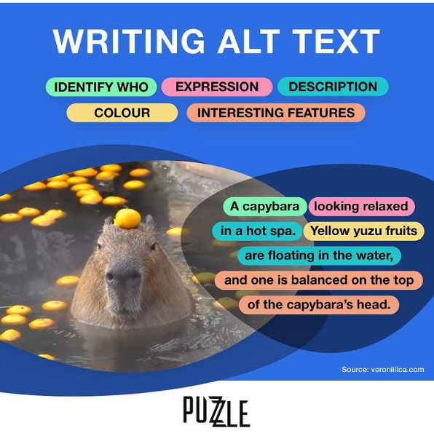
What to include
Notes:
Graphic explaining alt text: each aspect is highlighted a different color. Aspects include "identify who", "expression", "description", "colour", "interesting features."
There is an image with a description, with each aspect color coded. The text reads: A capybara (who) looking relaxed (expression), in a hot spa (description). Yellow yuzu fruits (colour) are floating in the water (description), and one is balanced on top of the capybara’s head (interesting feature).
You notice I’ve made the choice here not to use the color terms - that’s because some visually impaired readers might not care about color info, but also because then the reader has to mentally or manually flip back to see what those means. I went with the information label that’s indicated by the color instead.

Slide 21
What not to include
Don’t include information in the main text. Do expand on relevant visual details only in the image.
Don’t give personal opinions (most of the time): something is cute, ugly, etc. Personal social media might vary.
Don’t use emoji or lots of punctuation in alt text (see the transcription advice)

Slide 22
Where is this text going?
What’s the context this image is used in?
How much of the content is described in the article, post, etc?
Formal writing : clear, unbiased explanation.
Website : clear, focused on details most useful to audience
Social media : a bit more about vibes, may describe humor, etc.

Slide 23
Example : Helen and her dog
Studio portrait of 10-year-old Helen Keller standing next to her dog. Keller, a white girl, is facing sideways next to a chair with a spaniel sitting on it, who is likely her dog Belle. She rests her left hand on the dog's shoulder, her right hand is resting against the side of her dress in a fist, with one finger pointing downward. Keller wears a light-colored dress with a bow in the back and dark button-up boots. (Image from the Perkins Archives)
Notes:
Studio portrait of 10-year-old Helen Keller standing next to her dog. Keller, a white girl, is facing sideways next to a chair with a spaniel sitting on it, who is likely her dog Belle. She rests her left hand on the dog's shoulder, her right hand is resting against the side of her dress in a fist, with one finger pointing downward. Keller wears a light-colored dress with a bow in the back and dark button-up boots.

Slide 24
Alt text : Helen and her dog
Alt text:
Studio portrait of 10-year-old Helen Keller standing next to her dog.
Notes:
Studio portrait of 10-year-old Helen Keller standing next to her dog. Keller, a white girl, is facing sideways next to a chair with a spaniel sitting on it, who is likely her dog Belle. She rests her left hand on the dog's shoulder, her right hand is resting against the side of her dress in a fist, with one finger pointing downward. Keller wears a light-colored dress with a bow in the back and dark button-up boots.

Slide 25
Alt text : Focused on the dog
Alt text:
In this sepia tone studio portrait, Helen is about 10 and is posing with a spaniel, probably her dog Belle. The spaniel is sitting on a chair, and has a multicolored coat and white chest. [Possibly some doggy specifics here].
Additional images might have other dogs, Helen with dogs at other points in her life, etc.
Notes:
Studio portrait of 10-year-old Helen Keller standing next to her dog. Keller, a white girl, is facing sideways next to a chair with a spaniel sitting on it, who is likely her dog Belle. She rests her left hand on the dog's shoulder, her right hand is resting against the side of her dress in a fist, with one finger pointing downward. Keller wears a light-colored dress with a bow in the back and dark button-up boots.

Slide 26
Alt text : Focused on clothing
Alt text:
In this studio portrait c. 1890, Helen Keller is about 10, posing with a spaniel. She wears a plain light colored long-sleeve dress with a high collar belted with a bow in the back and dark button-up boots. Her hair is in curls and ringlets, pulled back from her face with curling bangs on her forehead.
Notes:
Studio portrait of 10-year-old Helen Keller standing next to her dog. Keller, a white girl, is facing sideways next to a chair with a spaniel sitting on it, who is likely her dog Belle. She rests her left hand on the dog's shoulder, her right hand is resting against the side of her dress in a fist, with one finger pointing downward. Keller wears a light-colored dress with a bow in the back and dark button-up boots.

Slide 27
Alt text : Focused on disability
Alt text:
In this studio portrait, Helen Keller is about 10 and is posing with a spaniel. Her right hand is resting against the side of her dress in a fist, with one finger pointing downward. She is facing to the right of the image, hiding the left side of her face.
Text might discuss that few images were taken from the other side at this point in her life.
Notes:
Studio portrait of 10-year-old Helen Keller standing next to her dog. Keller, a white girl, is facing sideways next to a chair with a spaniel sitting on it, who is likely her dog Belle. She rests her left hand on the dog's shoulder, her right hand is resting against the side of her dress in a fist, with one finger pointing downward. Keller wears a light-colored dress with a bow in the back and dark button-up boots.

Slide 28
Specifics : text
Start with Transcript
Write exactly what the text says.
Image tools can now get the text for you in many cases - check and correct the transcription!
Summary of emoji or punctuation strings is fine if it makes the content more understandable. “twenty-five exclamation points” or “five fireworks emoji”

Slide 29
Specifics : physical description
What is relevant?
What is different?
What is already identified in the text?
Notes:
(WebAIM example: already talking about a Hispanic astronaut and naming her.) Caption already says “As the first Hispanic woman to go to space, and, later, the first Hispanic director of Johnson Space Center, Ellen Ochoa is widely regarded as a role model.”

Slide 30
Specifics : gender, race, ethnicity
Describe everyone or no one this way.
What’s relevant (diverse group? people from a specific place?)
Don’t imply or add info not available to sighted users.
A note on reparative cataloging and description in archives.

Slide 31
Specifics : gender, race, ethnicity 2
Work from what is known from the image or text, not guesses.
What clothing are they wearing? (“All in skirts and dresses”, “all in shirts and trousers”, “in a mix of summer clothing”)
Skin tone: Use neutral descriptions - emoji skin tones work well
🏻 Light Skin Tone 🏼 Medium-Light Skin Tone 🏽 Medium Skin Tone 🏾 Medium-Dark Skin Tone 🏿 Dark Skin Tone.

Slide 32
Specific situations : charts
These need more length.
Describe in the text of the article (alt text just gives the visual info)
Link to a longer description on a separate page
Have a longer alt text description
Begin with a brief summary (phrase) : what is this?
Diagram Center guidelines: http://diagramcenter.org/table-of-contents-2.html

Slide 33
Specific situations : links
Not about images, but still important!
Use meaningful link text
Learn more about [topic] by exploring our catalog.
The Hayes Research Library can provide
Avoid “click here”.
Think about repeated link names that go to different locations.

Slide 34
Specific situations : locations
Getting too detailed about location can have safety implications.
Keep it to immediately known places or identified locations.
“If it’s a location I recognize but that is not well known, I will avoid including location info to avoid unintentionally exposing the person’s location- for example, I would not write the name of a local coffee shop my friend took a selfie in unless they tagged the location themselves or are standing under a sign.” - Veronica

Slide 35
Screen reader speed
Jason Holt, SLCC Universal Access department, screen reader user (4 min) https://www.youtube.com/watch?app=desktop&v=q_ATY9gimOM
Marc Sutton : UCSF (5 min) : demonstrates tables, images. https://youtu.be/dEbl5jvLKGQ?si=l2ST5B4jE9pH5F2r
Note that both of these users have slowed down their speed a lot so people not used to screen readers can make sense of it.

Slide 36
Resources, page 1
Perkins guide (written by Veronica Lewis/Veronica With Four Eyes, who is visually impaired). Links to many other resources. https://www.perkins.org/resource/how-write-alt-text-and-image-descriptions-visually-impaired/
WebAIM guide to Alternative Text: https://webaim.org/techniques/alttext/
Denise Paolucci resources : https://denise.dreamwidth.org/72793.html

Slide 37
Resources, page 2
Low budget implementable accessibility advice from the National Center on Deafblindness. Includes overview of other accessibility tips. https://www.nationaldb.org/for-state-deaf-blind-projects/accessibility-toolkit/accessibile-content/
Diagram Center Image Description Guidelines, templates, etc. http://diagramcenter.org/making-images-accessible.html

Slide 38
Resources, page 3
Cooper Hewitt Guidelines for Image Description - good for art, complex images. https://www.cooperhewitt.org/cooper-hewitt-guidelines-for-image-description
Daisy Consortium recorded webinars - three on image description https://daisy.org/webinar-series/

Slide 39
Resources, complete list
Perkins guide (written by Veronica Lewis/Veronica With Four Eyes, who is visually impaired). Links to many other resources. https://www.perkins.org/resource/how-write-alt-text-and-image-descriptions-visually-impaired/
WebAIM guide to Alternative Text: https://webaim.org/techniques/alttext/
Denise Paolucci resources : https://denise.dreamwidth.org/72793.html
Low budget implementable accessibility advice from the National Center on Deafblindness. Includes other accessibility tips. https://www.nationaldb.org/for-state-deaf-blind-projects/accessibility-toolkit/accessibile-content/
Diagram Center Image Description Guidelines, templates, etc. http://diagramcenter.org/making-images-accessible.html
Cooper Hewitt Guidelines for Image Description - good for art, complex images. https://www.cooperhewitt.org/cooper-hewitt-guidelines-for-image-description
Daisy Consortium recorded webinars - three on image description : https://daisy.org/webinar-series/
Jason Holt, SLCC Universal Access department, screen reader user (4 min) https://www.youtube.com/watch?app=desktop&v=q_ATY9gimOM and Marc Sutton UCSF (5 min) https://youtu.be/dEbl5jvLKGQ?si=l2ST5B4jE9pH5F2r
Notes:
Image examples from D: https://denise.dreamwidth.org/71796.html
Sample texts : https://denise.dreamwidth.org/72118.html

Slide 40
Perkins.org

