Slide 1
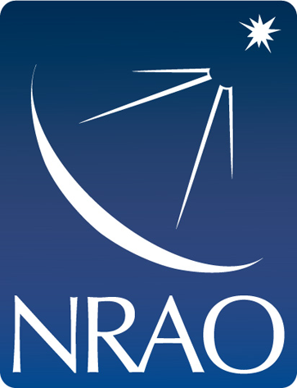
NRAO NINE Raspberry Pi project
By: Alexander Fortenberry

Slide 2
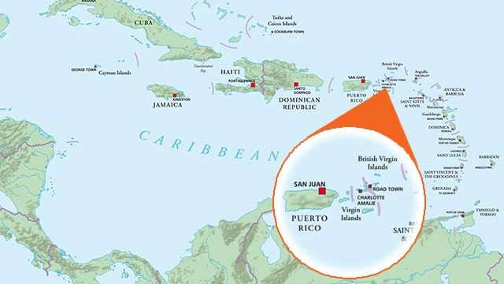

Slide 3
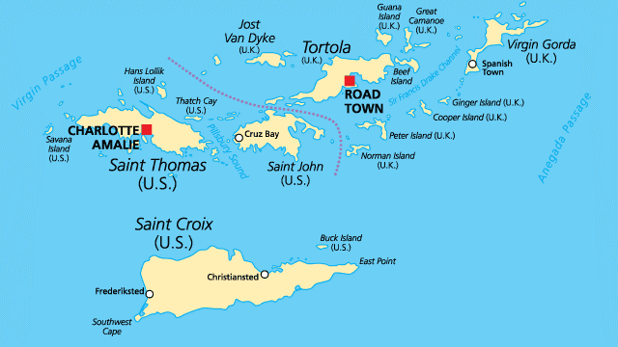

Slide 4
National and International Non-Traditional Exchange (NINE) Program
The NINE’s objectives are to increase diversity and improve the environment for diverse students to thrive.
Establish a NINE Hub at the our home institutes
Passing of knowledge: Each one teach one
Hands-On Experience
Use radio astronomy-related software
Specifically by using VLASS data and Raspberry Pis to analyze astronomical data

Slide 5
Nine
The NINE hubs will:
Serve as training grounds for development at each home location
Serve as a facilitator for encouraging additional NINE applications
Offer opportunities for NRAO employees and/or other Hub Trainers to deploy for short periods of study

Slide 6
VLASS: Very Large array sky survey
All-sky survey at a frequency of 3GHz (S-band)
3 epochs, 1 epoch every 3 years
Uses On-The-Fly mosaicking in order to do multi-epoch coverage
Observed the first half of the first epoch (roughly 17,000 sq deg)(Sep 2017 - Feb2018)
16,500 sq deg of quick look images were released to the community so far
Equivalent to 5s of time on source

Slide 7
VLASS: Very Large array sky survey
1x1 degree images
Stokes I continuum, U and Q polarizations
Quicklook images: 3722x3722
1 pixels =1.0 arcsec
Expected number of sources ~5 million

Slide 8
Project Goal
Lean to create a GUI via python
Make a project that is re-creatable (to an extent) on a shorter time scale
Advance my own python skills
Use Raspberry Pi to analyze VLASS data

Slide 9
Curriculum Requirements
Basic python knowledge
Strong math skills (ie: calculus I)
Basic statistical knowledge
VLASS observational parameters and imaging products
Python modules: Astropy, PyQt5, Numpy, Matplotlib, wget, pygame, pathlib
Knowledge of astronomical coordinate systems and image manipulation
Monitor, mouse, and keyboard
Raspberry Pi 3b

Slide 10
UVI’s NRAO NINE Program
RISE-UP: Radio Instrumentation STEM Education in UVI Physics
3-day Python workshop for UVI students (novice)
Basic python: principles of object oriented programing, introduction to pythonic concepts and solutions, loops, creating functions
Advanced python: threading, array handling, optimization, revision control (github, bitbucket), parsing and searching files
Practical use of python in astronomy: importing FITS, reading/editing headers, understanding the data, creating Gaussian fits

Slide 11
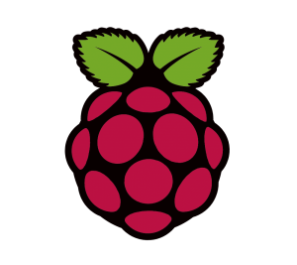
UVI’s NRAO NINE Program
3-day Raspberry Pi and data science workshop for UVI students
Python refresher course
Raspberry Pi information and uses
Raspberry Pi setup (from box to operation)
Data analysis (handling of large data sets)
Raspberry Pi project

Slide 12
Lessons Learnt
Revision control is IMPORTANT!!!
GUIs are incredibly tedious to write
Standard python threading and PYQT do not work well together
Patience is a virtue
Practice makes perfect
Finally getting everything to open as one is the best feeling in the world

Slide 13
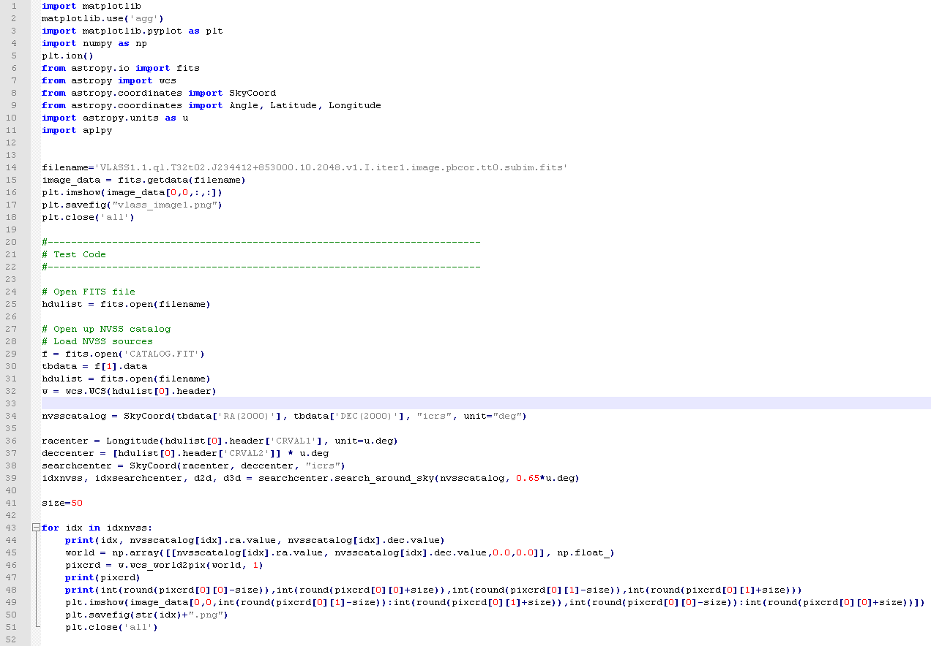
In the beginning there was…

Slide 14
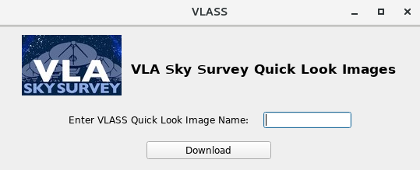
Tile: T05t33.J214353-233000

Slide 15
While waiting:
Acquires the fits
Finds sources
Gaussian fitting
Makes arrays of source names and stats
Makes plots
Finding and Analyzing Sources...
And then we wait

Slide 16
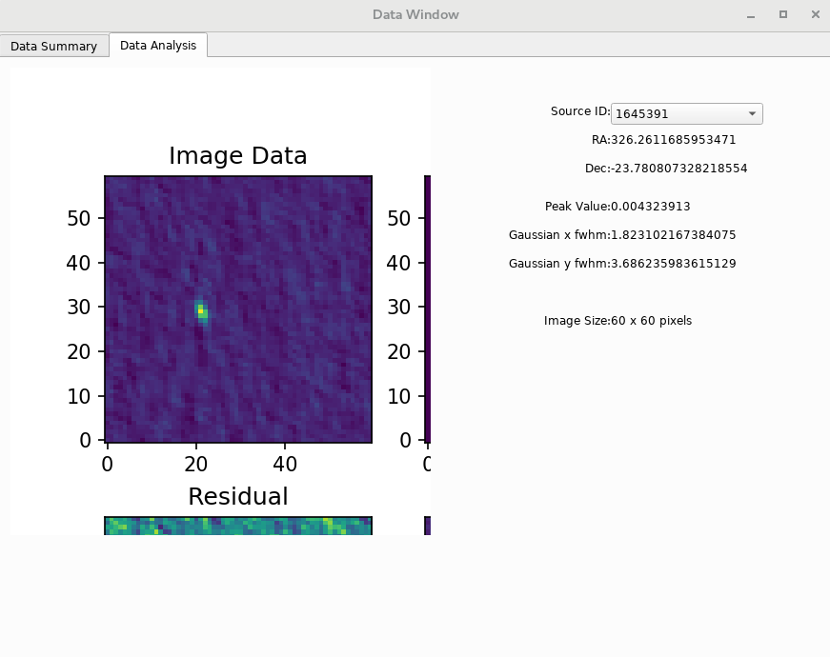
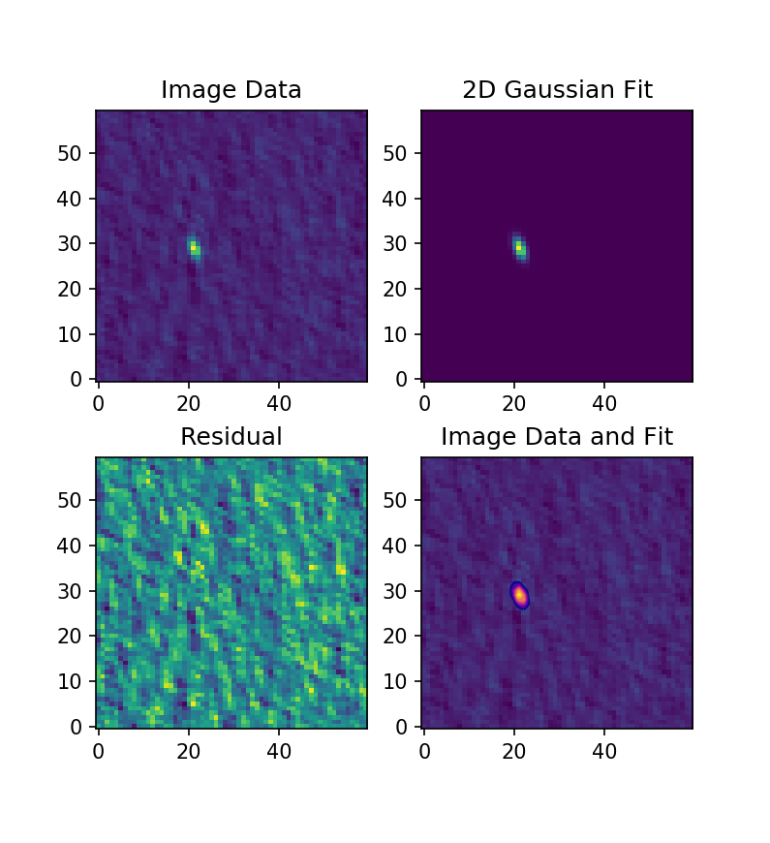

Slide 18
Future Work
Code optimization
Multi-source gaussian fitting
Source selection instead of analyzing the whole tile
Allow choice to select sources within a specified RA and Dec range
Multi-wavelength astronomy
Create deployment version

Slide 19
Lessons Learnt
Revision control is IMPORTANT!!!
GUIs are incredibly tedious to write
Standard python threading and PYQT do not work well together
Patience is a virtue
Practice makes perfect
Finally getting everything to open as one is the best feeling in the world

Slide 20
Credit and Special Thanks
Anja Fourie - NINE program lead
Brian Kent - NINE technical manager
Lyndele von Schill - The Director of Diversity & Inclusion at NRAO
Sponsors:

